Slide 2
first line of work
Work on oneself
Self Study – gain awareness and
increase the level of being
Study of the System
This is the most important line
Self-centered

Slide 3
SECOND line of work
Work with others
One cannot work by oneself
Based on relationship and interaction, but still focused on individual patterns of reactions to others
Friction, inconvenience, and difficulty of working with other people creates necessary shocks

Slide 9
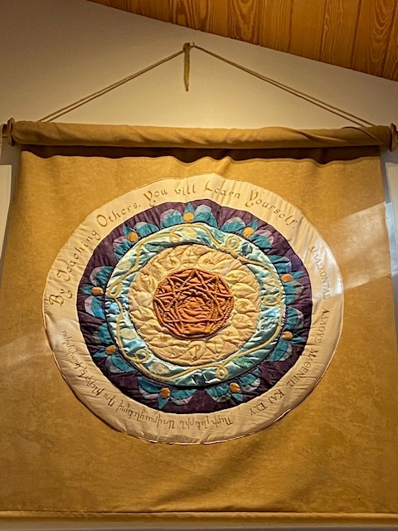

Slide 10
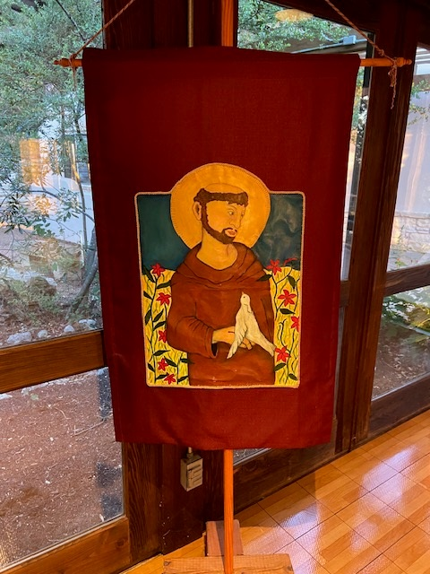

Slide 11
third line of work
Work for the School/Organization
Done for the benefit of the Work itself
Takes on different aspects for different people

Slide 12
All three
3 octaves going on simultaneously and parallel to each other
They do not begin at the same time
If equally energetic in all three lines, it leads you out of many accidental happenings
Right/Good & Wrong/Bad

