Slide 1
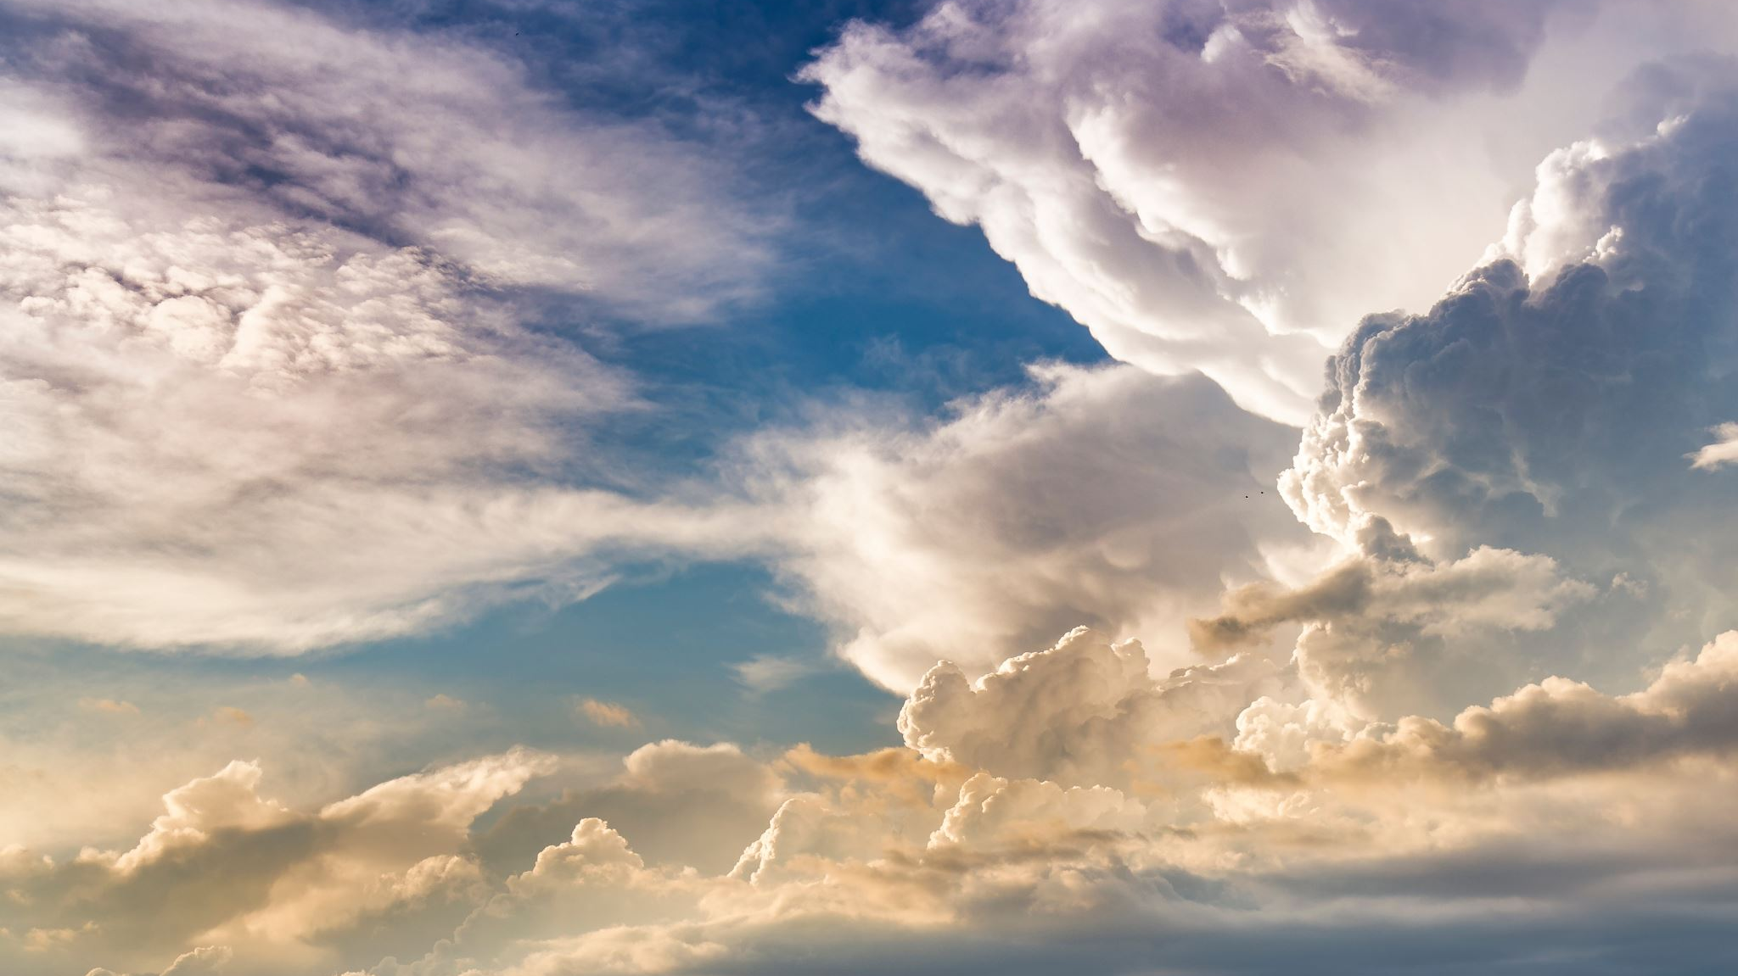
REMEMBERING OUR DYING
10/26/2023

Slide 2
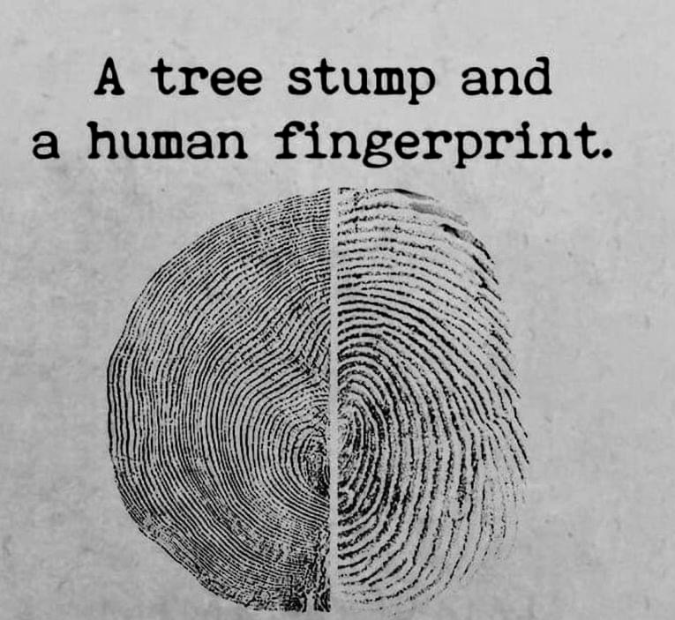
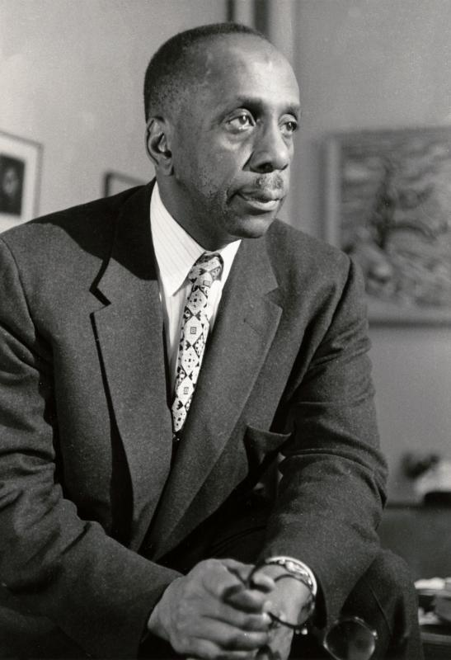
”Look well to the growing edge. All around us worlds are dying, and new worlds are being born. Life is dying, and life is being born. The fruit ripens on the tree, the roots are silently at work in the darkness of the earth against a time when there shall be new lives, fresh blossoms, green fruit. Such is the growing edge…..The birth of the child – life’s most dramatic answer to death – this is the growing edge incarnate. Look well to the growing edge”
Howard Thurman
Through every being single space extends
Outer space within.
Through us the birds fly silently
Oh, I who’d grow,
I look outside and in me grows the tree
Rainer Maria Rilke

Slide 3
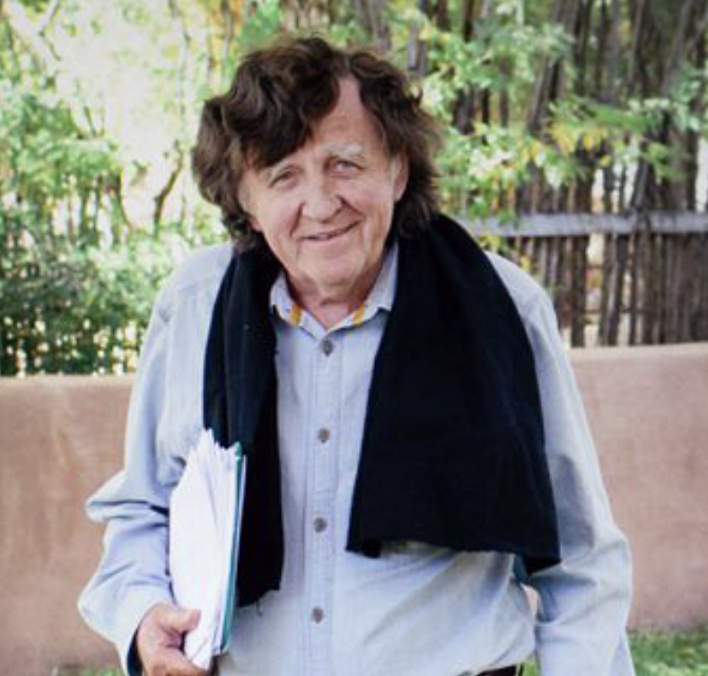
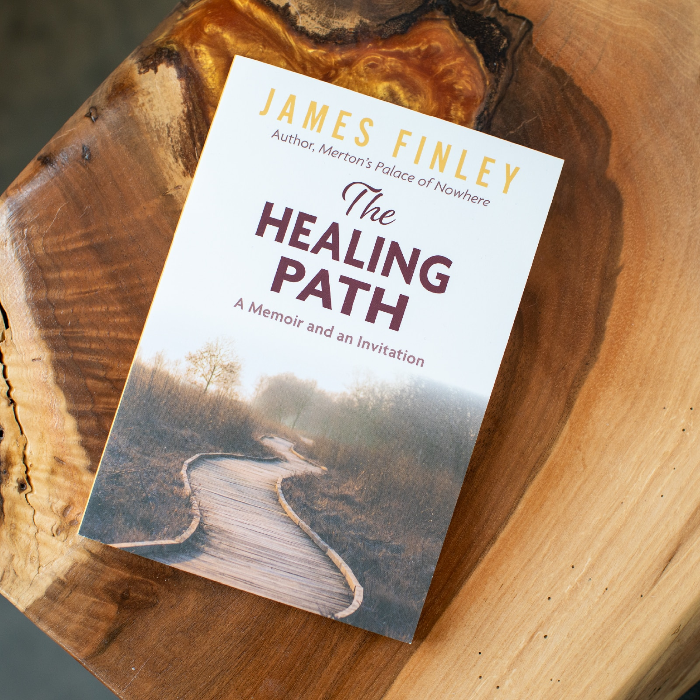
A BRIEF MEDITATION

Slide 4
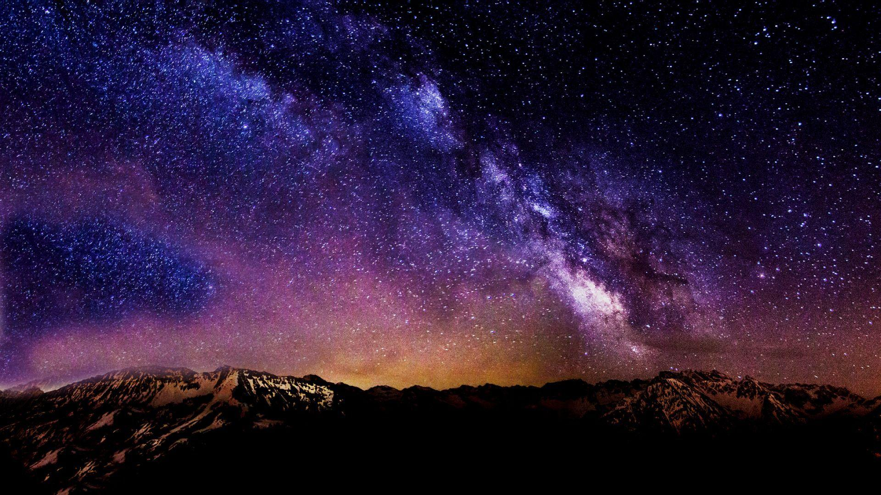

Slide 5
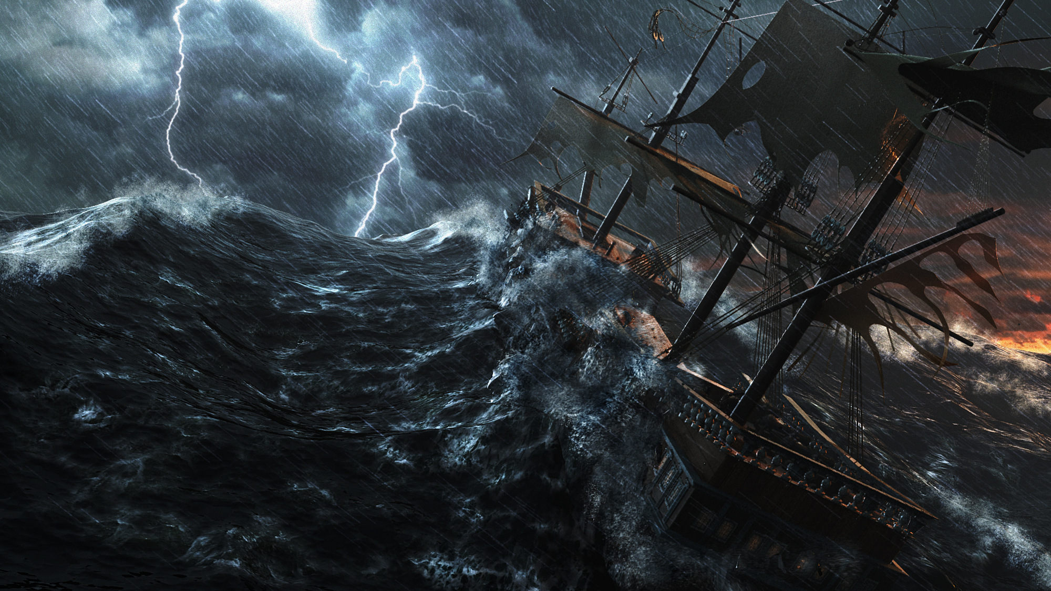

Slide 6
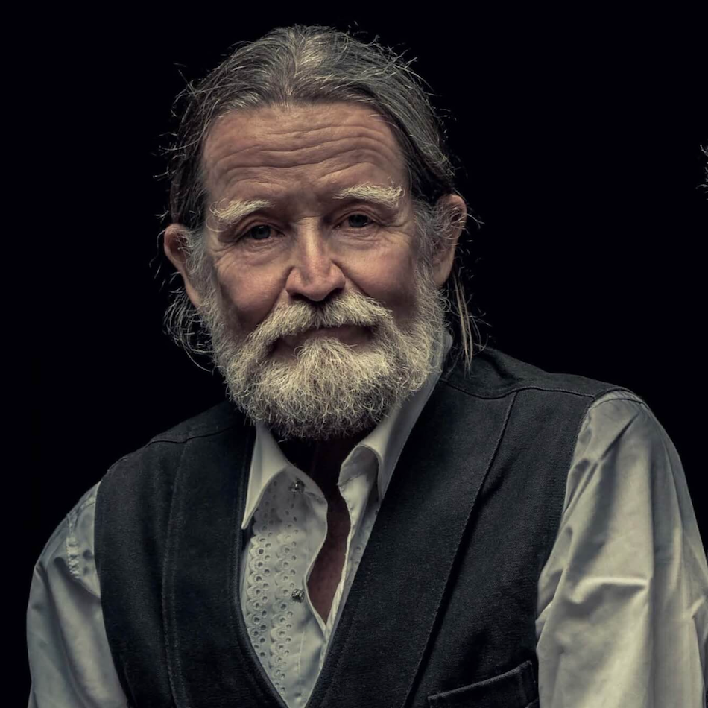
We could be a trustworthy achievement.
We could bequeath to the young people attending to the end of our days – often at too much of a distance – and to the children and babies who have no memory of us at all, a story of a dying life that is faithful to the struggle of being human when the seduction and the pull is so much otherwise, a story so true and indelible that it shines best and brightest in the darkest time, like stars in a clear, country sky night.
Stephen Jenkinson

Slide 7
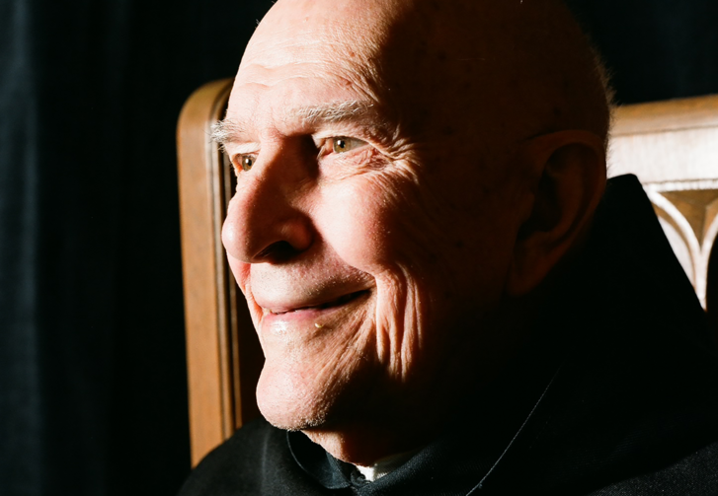
Death seems to be a process of transformation.
For that reason, it’s not really death, but life reaching out to a fullness that we can’t imagine from this side of the dying process.
So, death is not the end of anything but the final completion of this process of becoming fully alive and manifesting the triumph of the grace of God in us
Thomas Keating

Slide 8
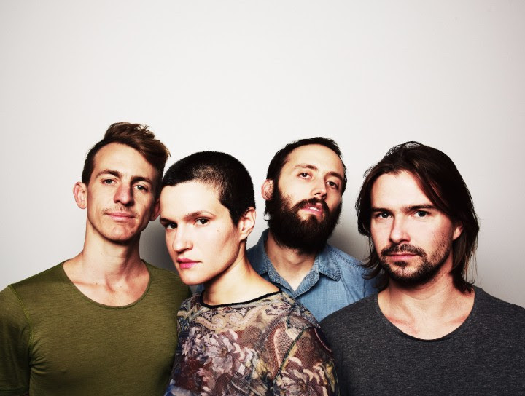
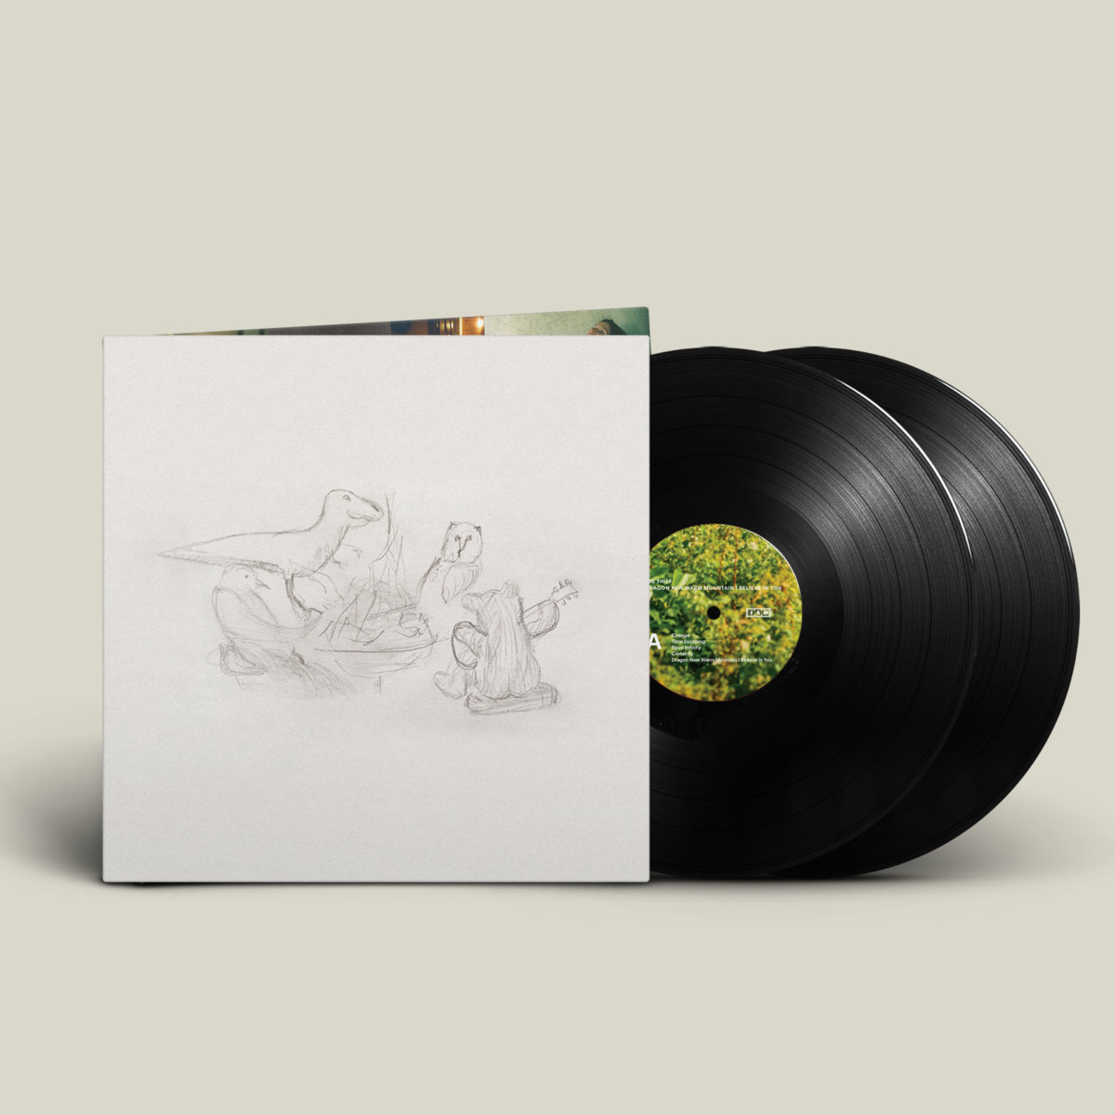
Change, like the wind, like the water, like skin Change, like the sky, like the leaves, like a butterfly Would you live forever and never die While everything around passes? Would you smile forever and never cry While everything you know passes? Death, like a door to a place we've never been before Death, like space, the deep sea, a suitcase Would you stare forever at the sun Never watch the moon rising? Would you walk forever in the light To never learn the secret of the quiet night?
Adrianne Lenker
BIG THIEF
Dragon Warm Mountain I Believe in You

Slide 9
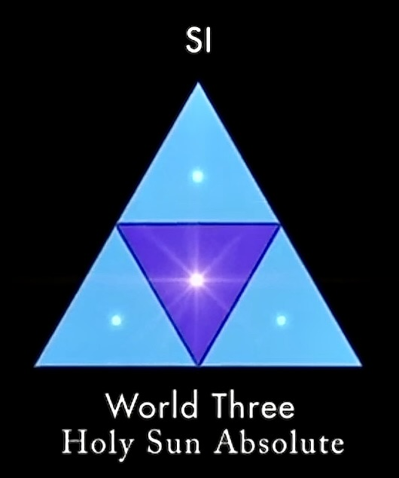
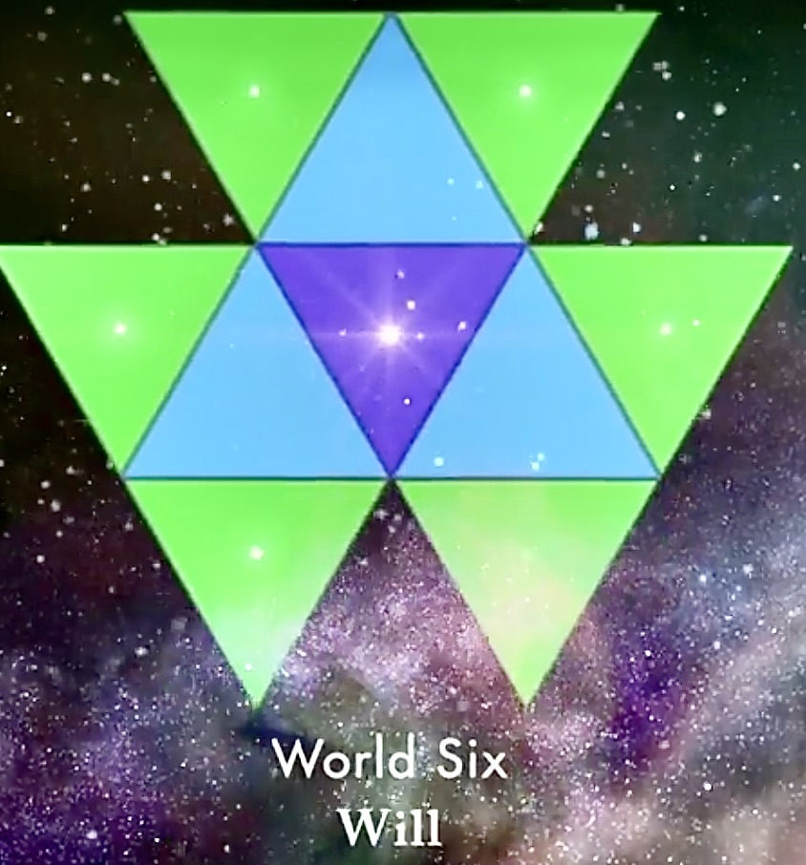
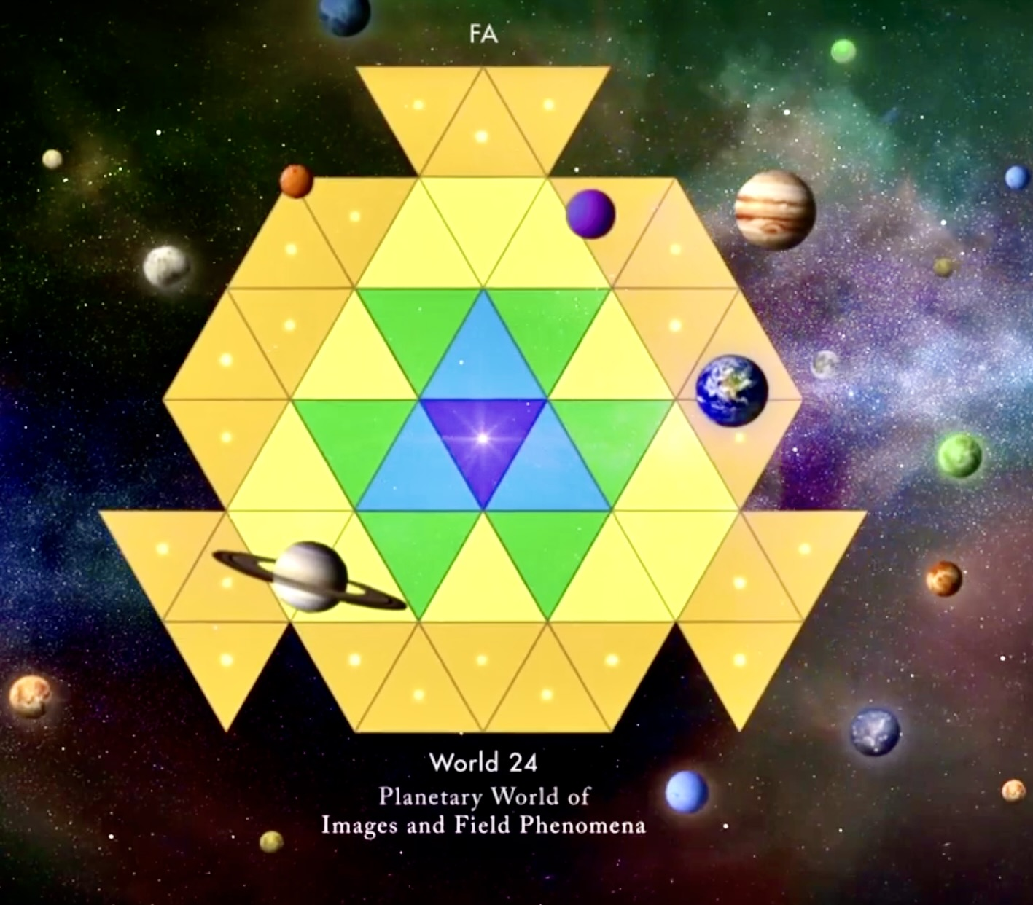
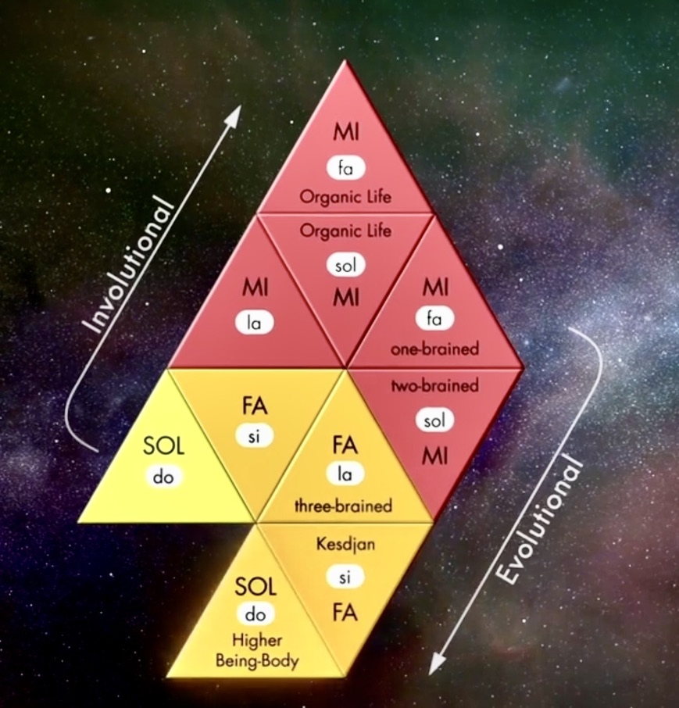
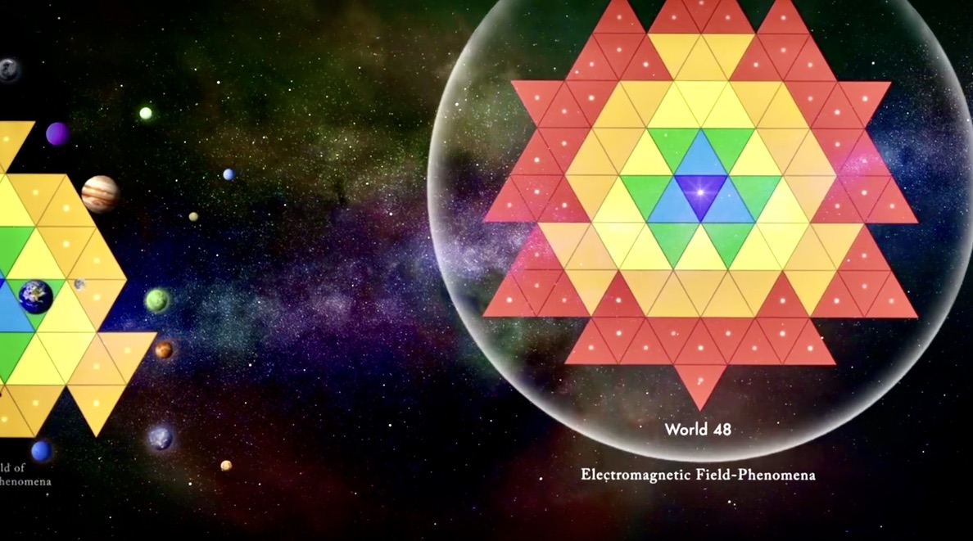

Slide 10
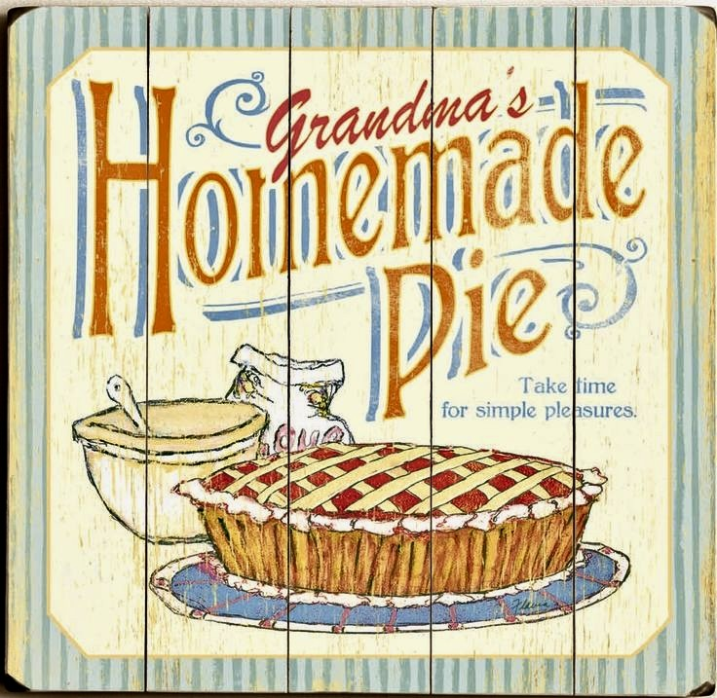
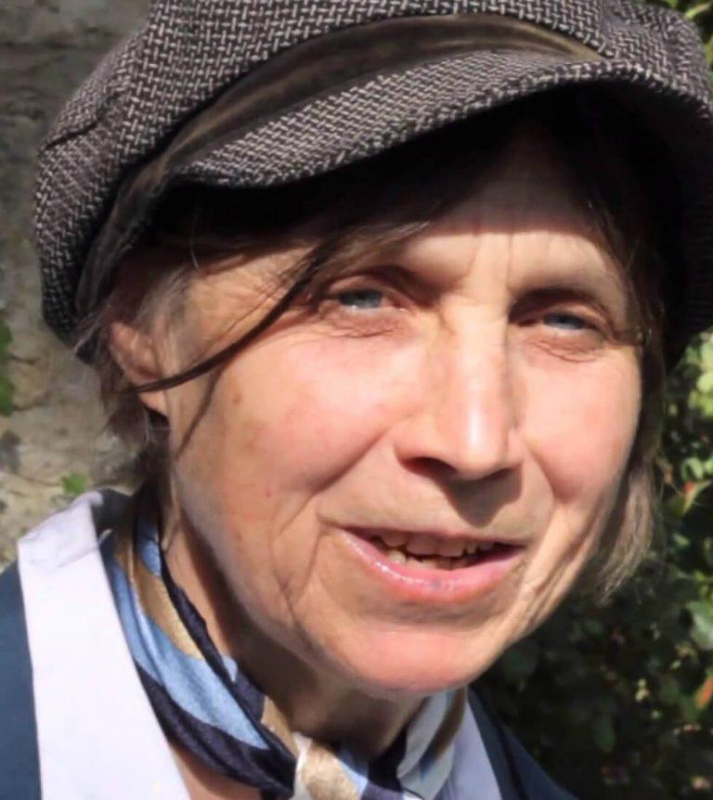
Agape love does not exist in a ‘natural’ state. It is an alchemical substance, forged when the raw primal force, eros, is subjected to the sacramental act of surrender or kenosis. Finitude is a necessary condition for the final revelation of love; it furnishes the backboard for surrender. When constricted by finitude, it finally bears fruit
AGAPE

Slide 11
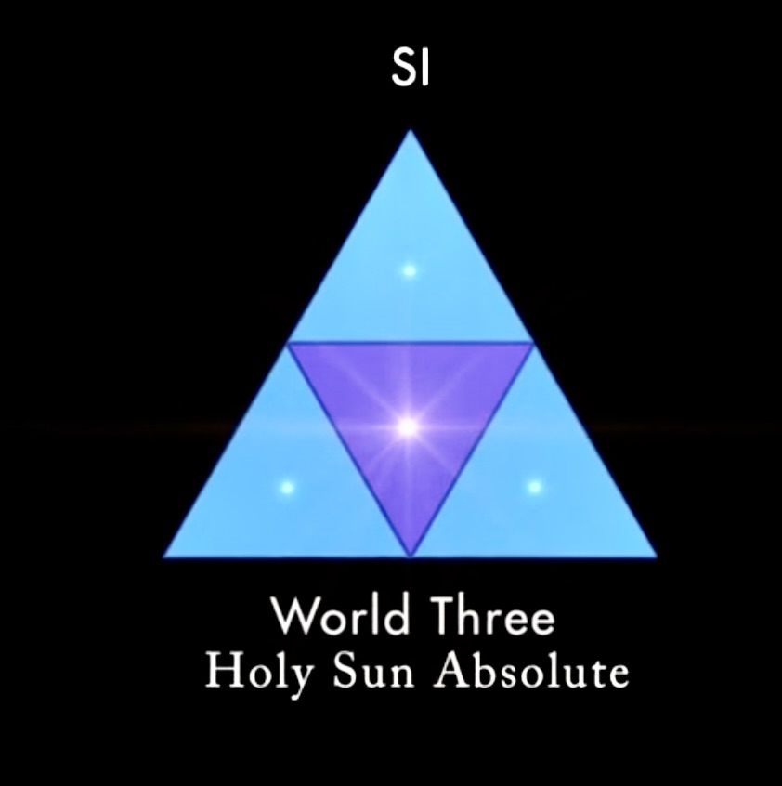
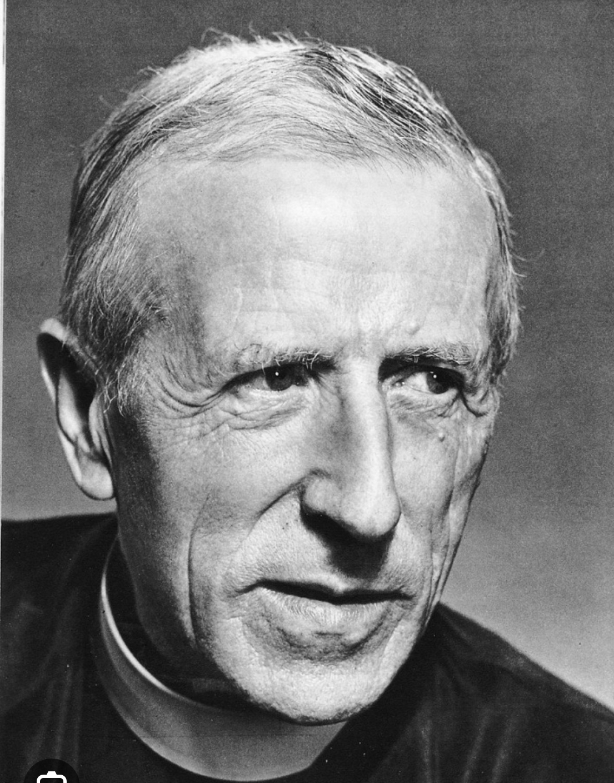
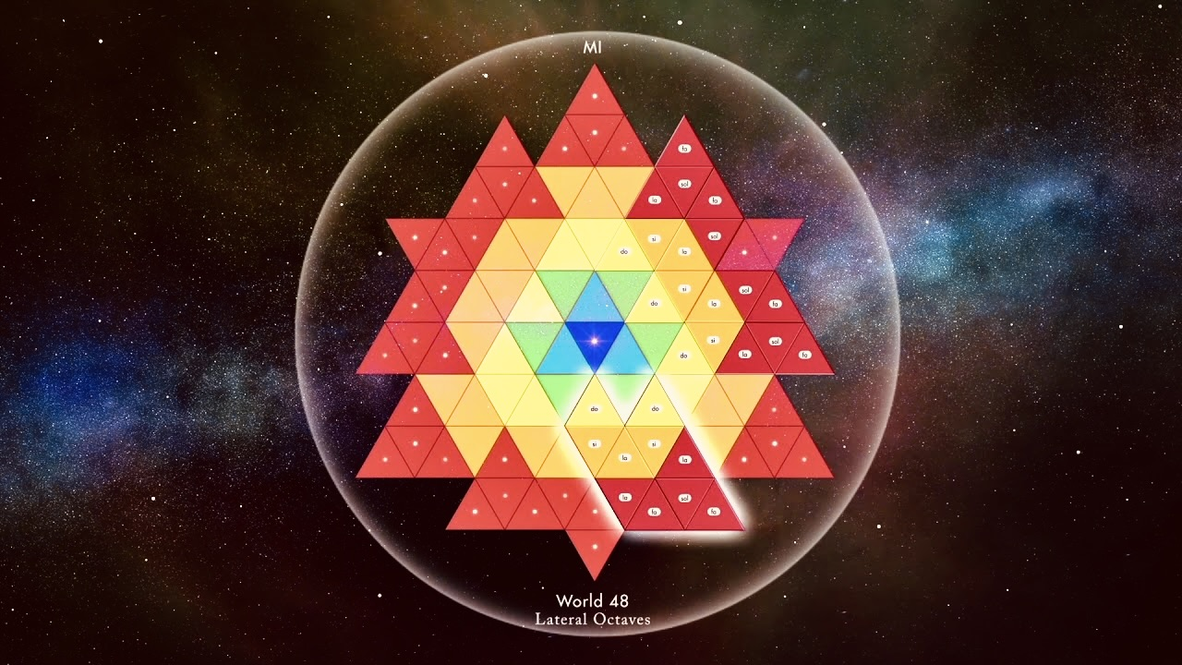
OUR COVENANT WITH GOD
No God (up to a certain point..) without Creative Union
No creation without Incarnational Immersion
No Incarnation without Redemptive Repayment (specific effort towards unification, overcoming a sort of inertia & tendency to fall back to multiplicity (Work Effort))
Pierre Teilhard de Chardin Toward the Future p. 198

Slide 12
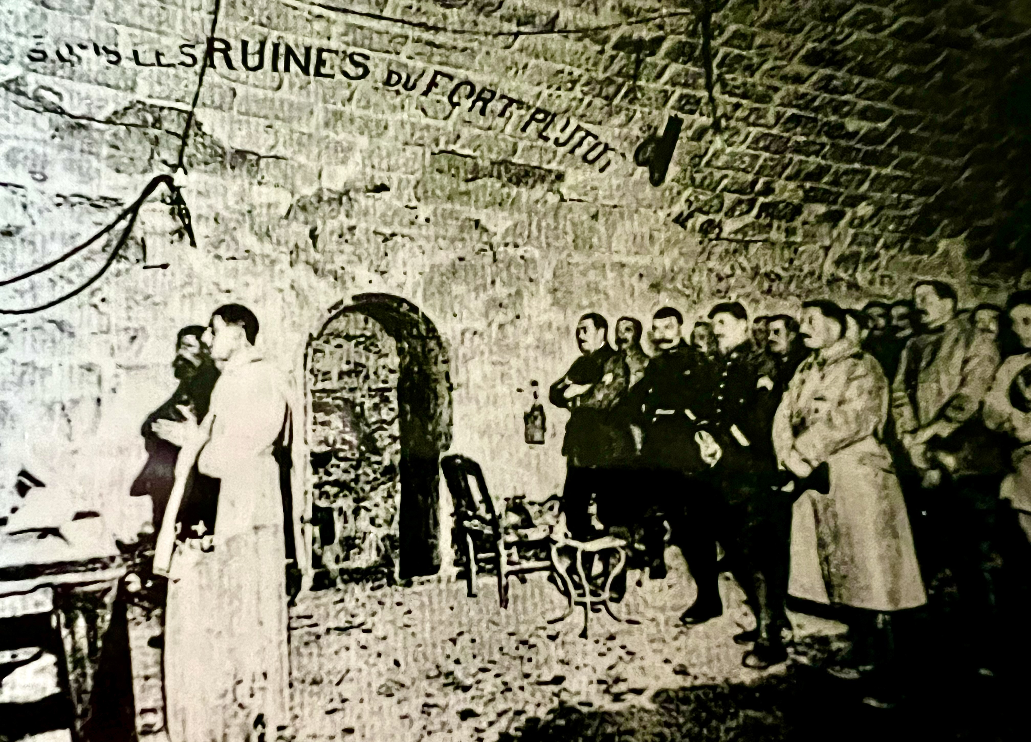
Germans sent a hail of shells down on our sector. Not a one of us was touched by the bursts. Teilhard said “I had still my blessing to give you. God being with us did not wish one of us to be hit.” I asked Pere Teilhard, “What do you do to keep this sense of calm during battle?” With a friendly smile, He said,
“If I’m killed, I shall just change my state, that’s all.”

Slide 13
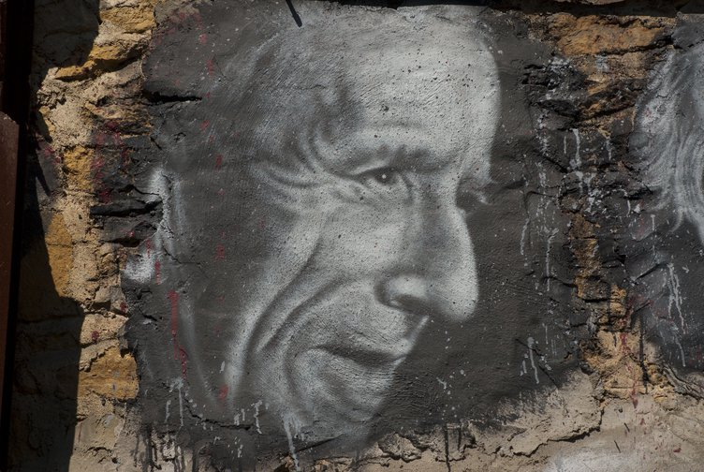
DEATH SURRENDERS US TOTALLY TO GOD; IT MAKES US ENTER INTO HIM;
WE MUST, IN RETURN, SURRENDER OURSELVES TO DEATH WITH ABSOLUTE LOVE AND ABANDONMENT – SINCE WHEN DEATH COMES, ALL WE CAN DO IS TO SURRENDER OURSELVES COMPLETELY TO THE DOMINATION AND GUIDANCE OF GOD. I FEEL THAT THERE IS SOMETHING TO SAY ABOUT THE HEALTHY JOY OF DEATH, ABOUT ITS HARMONY IN LIFE, ABOUT THE INTIMATE CONNECTION YET BARRIER BETWEEN THE WORLD OF THE LIVING, ABOUT THE UNITY OF BOTH IN ONE AND THE SAME COSMOS. DEATH HAS BEEN TREATED TOO MUCH AS A SUBJECT FOR MELANCHOLY REFLECTION, OR AS AN OCCASION FOR SELF DISCIPLINE, OR AS A HAZY THEOLOGICAL ENTITY. WHAT WE HAVE TO DO IS TO SEE IT IN ITS TRUE CONTEXT, SEE IT AS AN ACTIVE REALITY, AS ONE MORE PHASE, IN A WORLD AND A “BECOMING”.
THE MAKING OF A MIND PP 144-6

Slide 14
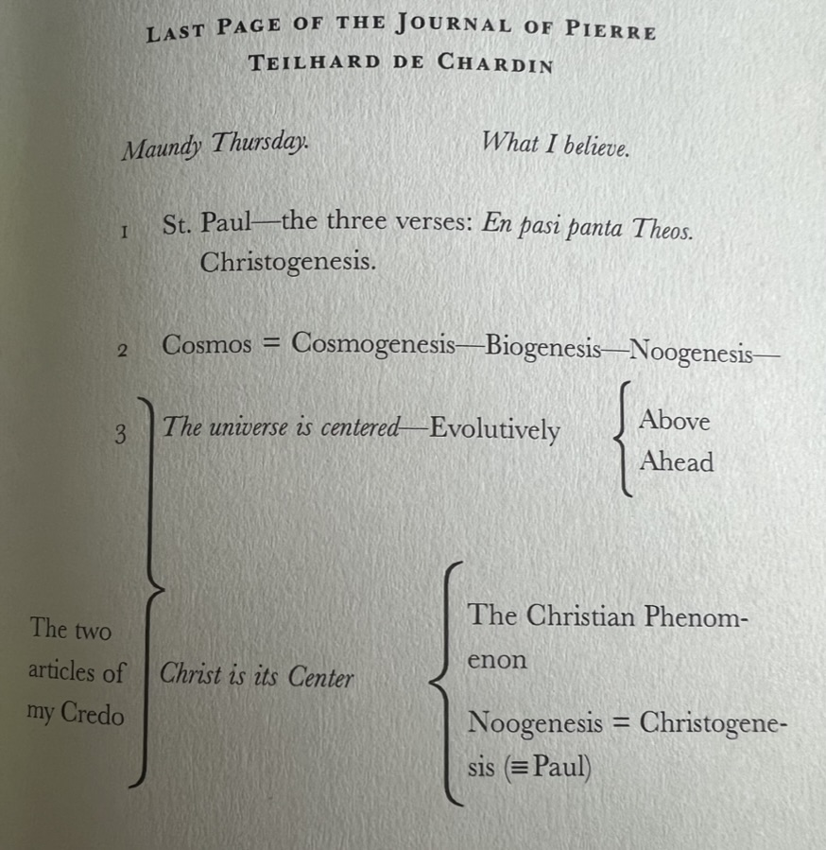
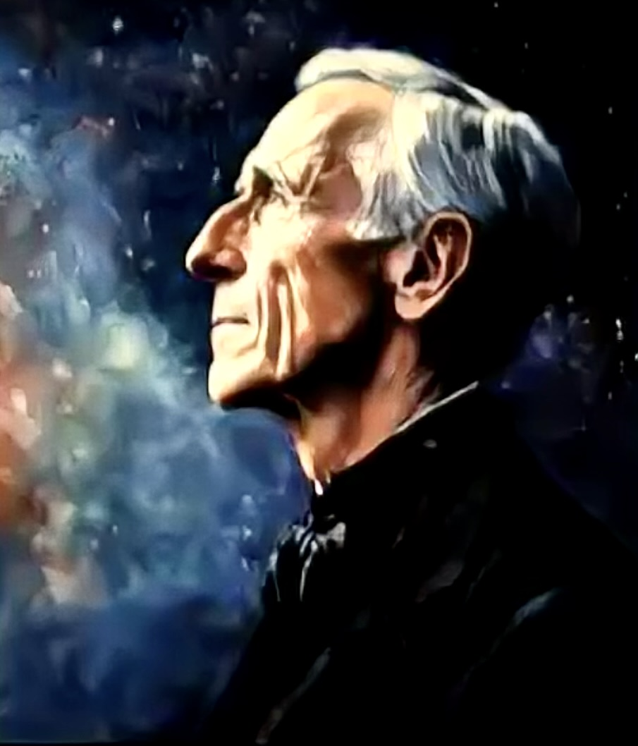

Slide 15
ST PAUL’S 3 VERSES ON CHRISTOGENESIS
1 Corinthians 15:26-28
26 The last enemy to be destroyed is death.
27 For he “has put everything under his feet”. Now when it says that “everything” has been put under him, it is clear that this does not include God himself, who put everything under Christ.
28 When he has done this, the the Son himself will be made subject to him who put everything under him, so that God may be all in all.

Slide 16
MASS ON THE WORLD (ABRIDGED)
“Since once again, Lord…I have neither bread, nor wine, nor altar, I will raise myself beyond these symbols, up to the pure majesty of the real itself; I, your priest, will make the whole world my altar and on it will offer you all the labors and sufferings of the world.
All the things in the world to which this day will bring increase; all those that will diminish; all those, too, that will die: all of them, Lord, I try to gather into my arms so as to hold them out to you in offering. This is the material of my sacrifice, the only material you desire.
This bread, OUR TOIL is of itself, I know, but an immense fragmentation; this wine, OUR PAIN, is no more, I know, than a draught that dissolves. Yet in the very depths of this formless mass you have implanted- and this I am sure of, for I sense it – a desire, irresistible, hallowing, which makes us cry out, believer and unbeliever alike: “LORD, MAKE US ONE.”

Slide 17
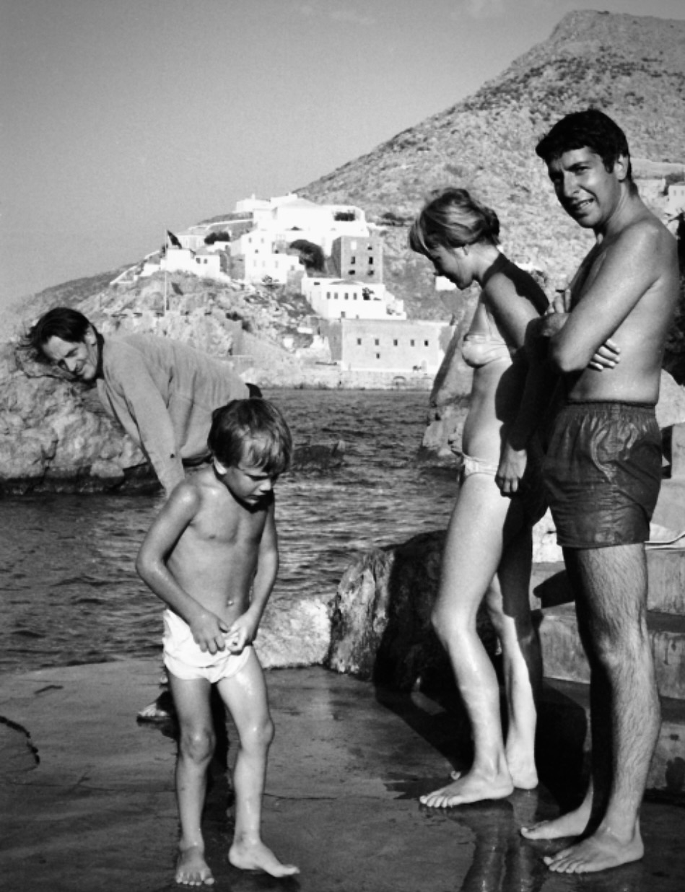
Greece is a good place to look at the moon, isn’t it?
You can read by moonlight.
You can read on the terrace.
You can see a face as you saw it when you were young.
It was a good light then, oil lamps and candles.
And those little flames that floated on cork and olive oil.
What I loved in my old life, I haven’t forgotten
It lies in my spine.
Marianne and the child and the days of kindness
It lives in my spine, and it manifests as tears.
I pray that a loving memory exists for them too.
The precious ones I overthrew for an education in the world.”
Dearest Marianne
“I’m just a little behind you.
Close enough to hold your hand.
This old body of mine has given up, as yours has too.
I’ve never forgotten your love and your beauty.
But you know I don’t have to say more.
Safe travels, old friend
See you down the road.
Endless love and gratitude.”
Your Leonard

Slide 18
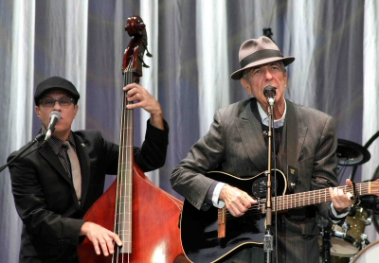

Slide 20
QUESTIONS & DISCUSSION

