Slide 1
Homework from last week
What is the one thing and how do I find it?
Certainly, it begins with finer influences. Let us ask ourselves: What are the influences we are placing ourselves under?
This week, be mindful of them, intentionally choose.

Slide 2
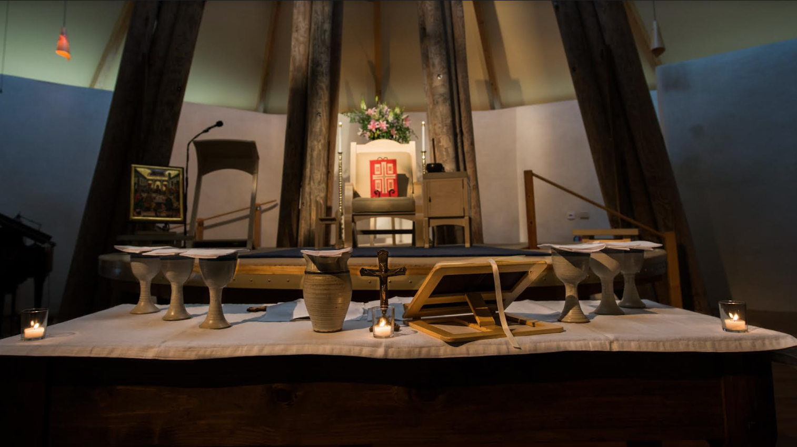
Reciprocal feeding of all that is
Preparing the Offering

Slide 3
Opening note
“Another’s truth is worse than a lie, because it is two lies.” J. G. Bennett

Slide 4
“God, for his purpose, in order to maintain perpetual motion, designed that each order of being feed on some other and be fed on.”
A.R. Orage

Slide 5
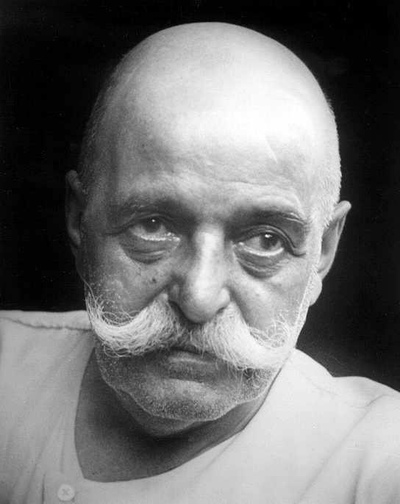
“What in general is the sense of man’s existence.”
G.I. Gurdjieff

Slide 6
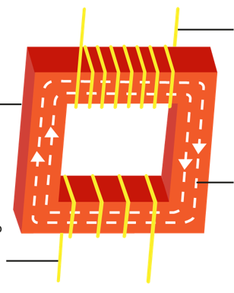
High Voltage
"Whatever we like to think we're up to in our philosophical or spiritual fantasies…in terms of cosmic exchange, we are transformers, of molecules and of meaning in equal measure. It is the cosmic function, apportioned to us... "
Cynthia Bourgeault
Magnetic
Field
Low Voltage
Our role

Slide 7
The Five Obligolnian Strivings
Man’s Cosmic Role
World
5th Striving
The striving always to assist the most rapid perfecting of other beings, bot those similar to oneself and those of other forms, up to the degree of the sacred Marfotai, that is up to the degree of self-individuality.
Will
6
The striving from the beginning of their existence to pay for their arising and their individuality as quickly as possible, in order afterwards to be free to lighten as much as possible the Sorrow of our Common Father.
4th Striving
Aim
12
Self-Remembering Transformer
Becoming Man 4
3rd Striving
The conscious striving to know ever more and more concerning the laws of World Creation and World Maintenance.
24
2nd Striving
To have a constant and unflagging instinctive need for self-perfection in the sense of being.
48
Food for the Moon
Man 1, 2, 3
1st Striving
To have in their ordinary being-existence everything satisfying and really necessary for their planetary body.
96

Slide 8
Reciprocal Feeding
“The Doctrine of Reciprocal Maintenance states that everything that exists in this world depends on other things for its maintenance and must in turn maintain the existence of others, and that this also applies to us.”
J. G. Bennett

Slide 9
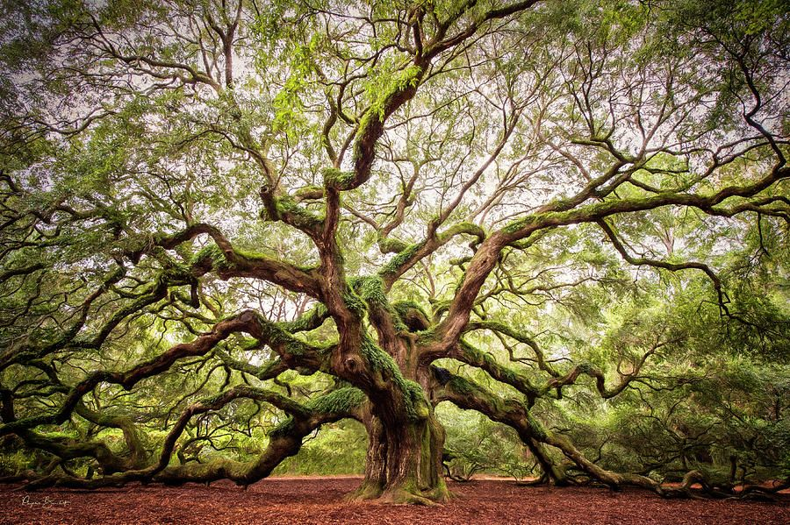
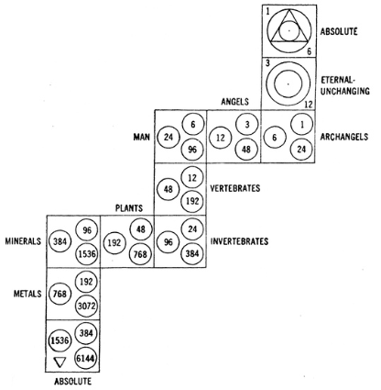
Reciprocal feeding of all that is

Slide 10
The diagram of everything living…
Man 4
Man 1, 2, 3
Unreal

Slide 11
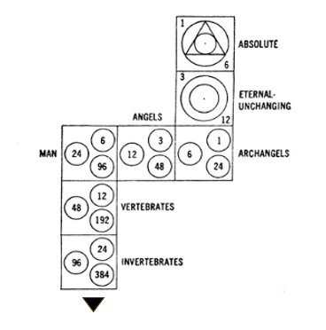
3
6
Archangels
Spiritual
Man 4
12
Angels
Transformer
24
Man 4
Man 1, 2, 3
Material
48
Man 1,2,3
Unreal
96
Unreal
Step diagram and the octave

Slide 12
The Lord’s Prayer
The Eucharist
Our father who art in heaven
Hallowed be thy name
Thy kingdom come
3
Thy will be done on earth as it is in heaven
6
Archangels
Will
Give us this day our daily bread
12
Angels
Aim
And forgive us our debts
24
Man 4
Self Remembering
As we forgive our debtors
Conscious breath
And lead us not into temptation
48
Man 1,2,3
Non-Identify
And deliver us from evil
96
Unreal
Self-Observe
For thine is the kingdom, the power and the glory, forever and ever
Ask for help
Preparing the Offering

Slide 13
Your offerings

