Slide 1
Our Homework from last week
Choose one of the Strivings to work with this week, intentionally, specifically, perhaps in a very small, practical way.
If you have studied the Work for some time, perhaps you feel that you need only to focus on the Fourth and Fifth Strivings. Work against this and practice the First, Second or Third Striving. What did you discover?

Slide 2
Salvation as Transformation
The Journey School July 20, 2023​​

Slide 3
What gets transformed?
Our Personality
Our knowledge & Being
Our Multiplicity
Our sleep & mechanicalness
Our negative thoughts & emotions
Our affect & body language
Our past & future

Slide 4
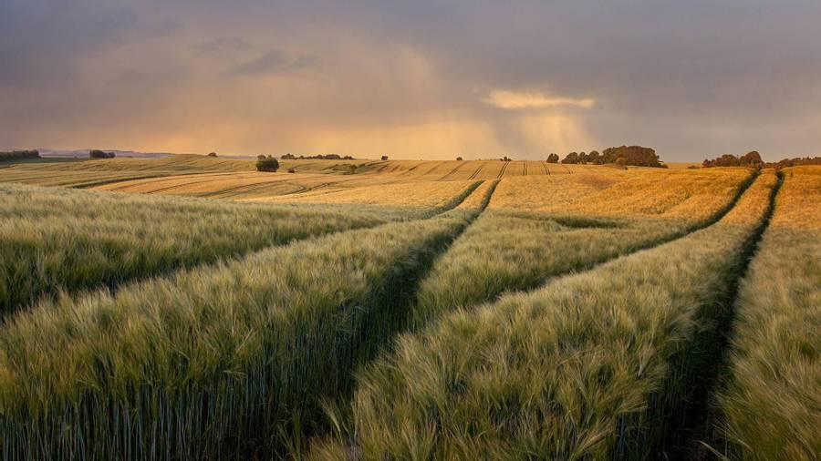
Personality can become passive

Slide 5
Knowledge & Being can deepen

Slide 6
From Multiplicity to Wholeness

Slide 7
From Sleep to Being awake & conscious

Slide 8
Non-Identified & Free

Slide 9
Consciously Embodied

Slide 10
Past/No Accounts or Future Anxiety

Slide 11
“If anyone is in Christ, there is a new creation. The old has gone, the new has come.” - 2 Corinthians 5.17

Slide 12
“I am the true vine, and My Father is the vinedresser. Every branch in Me that does not bear fruit Abba takes away; and every branch that bears fruit Abba prunes, that it may bear more fruit. You are already open because of the word which I have spoken to you. Abide in Me, and I in you. As the branch cannot bear fruit of itself, unless it abides in the vine, neither can you, unless you abide in Me. “I am the vine, you are the branches. The one who abides in Me, and I in that one, bears much fruit; for without Me you can do nothing.”
- John 15.1-7

Slide 13
“Now Jesus did many other signs in the presence of his disciples, which are not written in this book. But these are written so that you may come to believe that Jesus is the Messiah, the Son of God, and that through believing you may have life in his name.”
- John 20.30-31

Slide 14
HOmework
View Ted Nottingham’s video, “What This Inner Work is About," to glean the fruits from participating in this journey of transformation, that is, awakening unto salvation. It is 9.05 minutes in length. Or, view Thomas Keating’s video, "To Be Transformed," for the essence of the journey. It is 42 seconds in length.
Psychologically and spiritually speaking, observe where sleep is occurring in your life. What type of situations put you to sleep? What does it feel like to be asleep? What is the process like for you waking up? And how does sleep impact your will?
Review your year so far. How is Holy Remembering helping you awaken. How have you been transformed through this Work?

