Slide 1
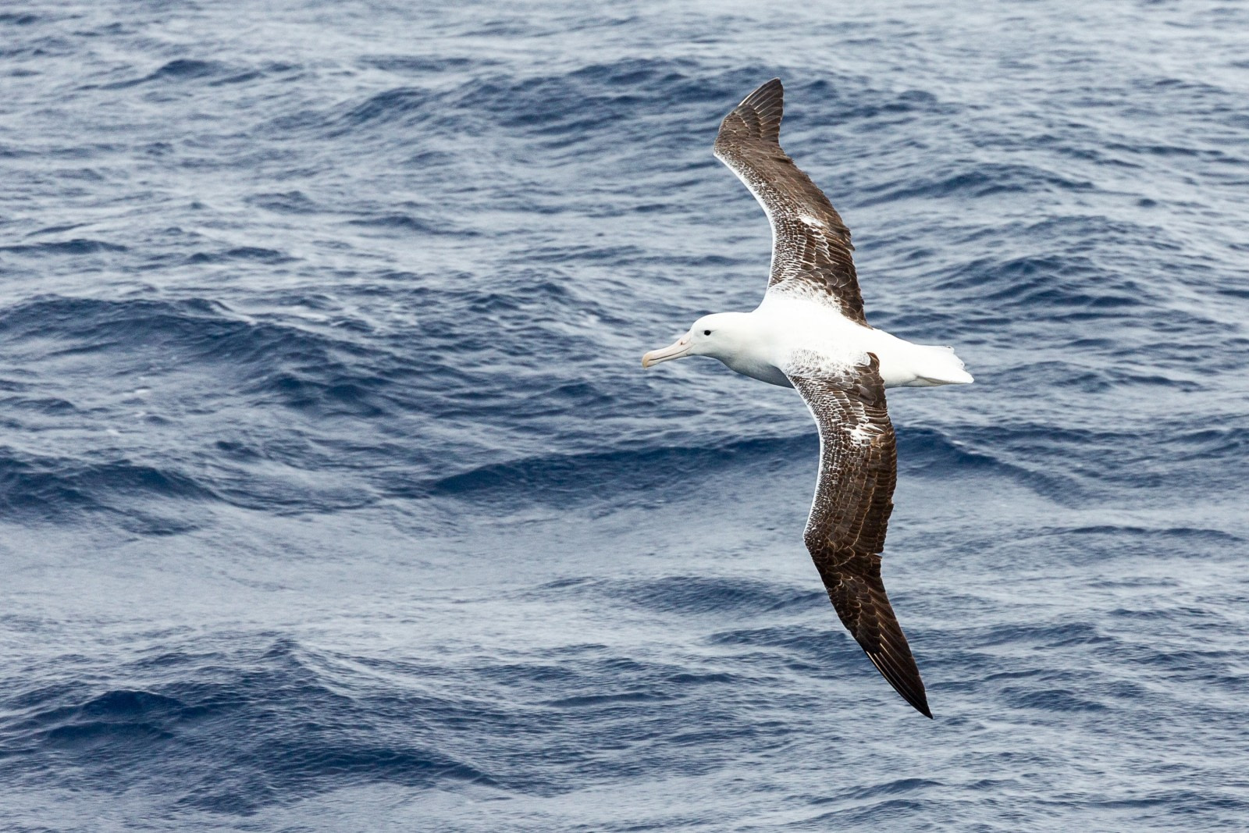
Homework
Identify ways in which you are making payment with gratitude and generosity to and for the Work. Where are you not grateful? Where are you constricted, and non-generous?
Discern how you might make payment toward the future of the Work. How can you contribute? How can you double-down on using your gifts for others and for the Work?
What role does rest play in your ability to Work? Take rest in these summer months and see how rest might play into your Work journey.

Slide 2
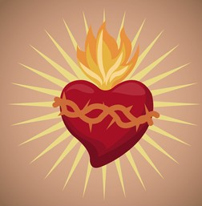
CONSCIOUS LOVE

Slide 3
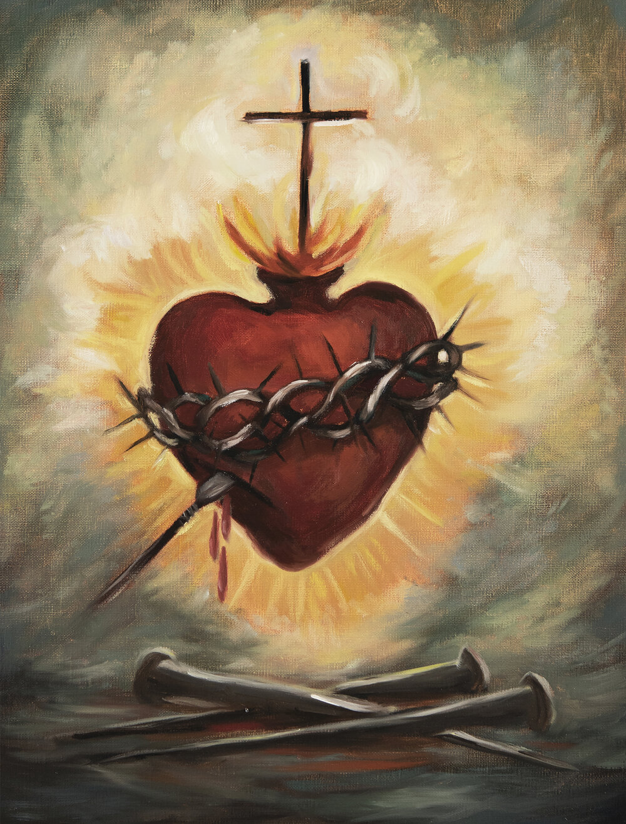
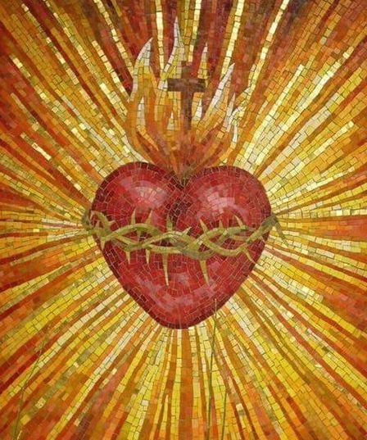
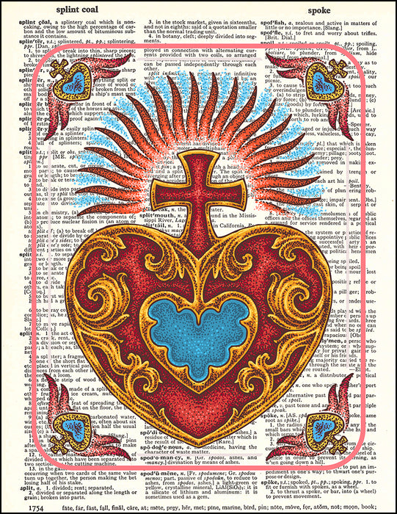
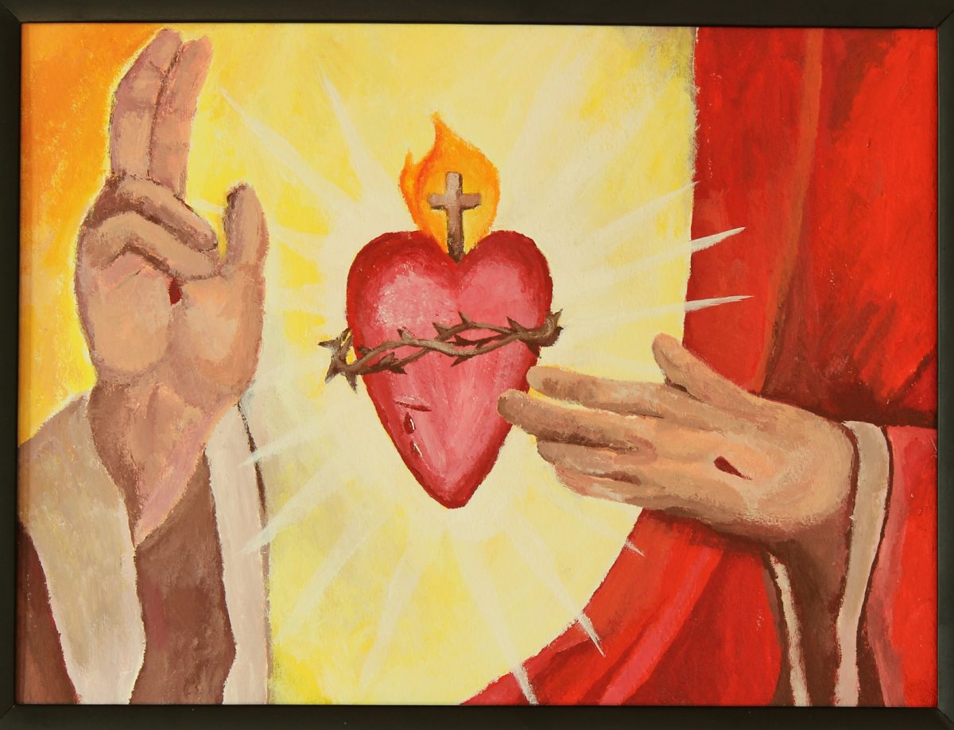

Slide 4
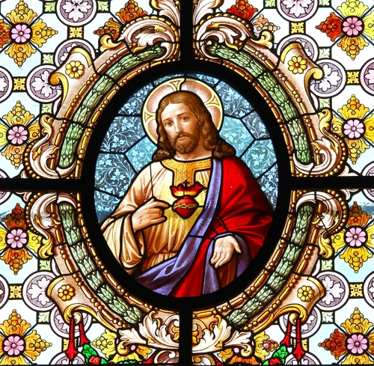

Slide 5
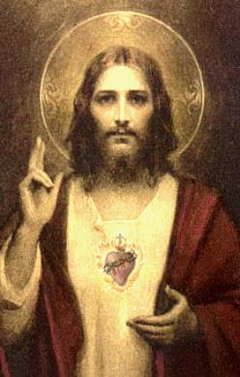

Slide 6
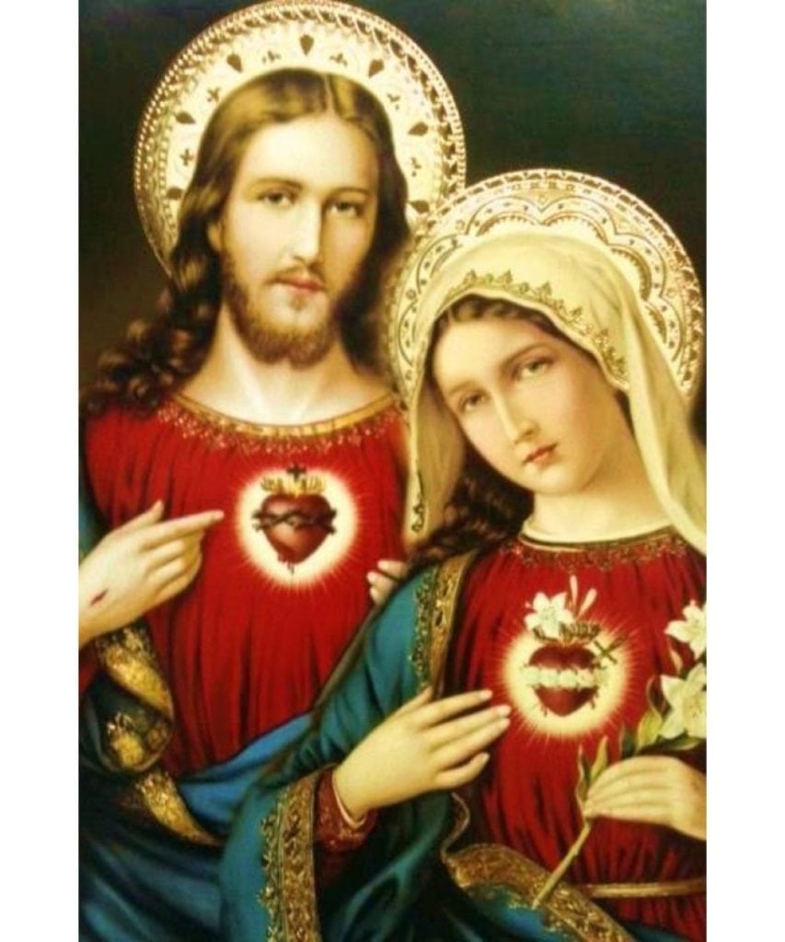

Slide 7
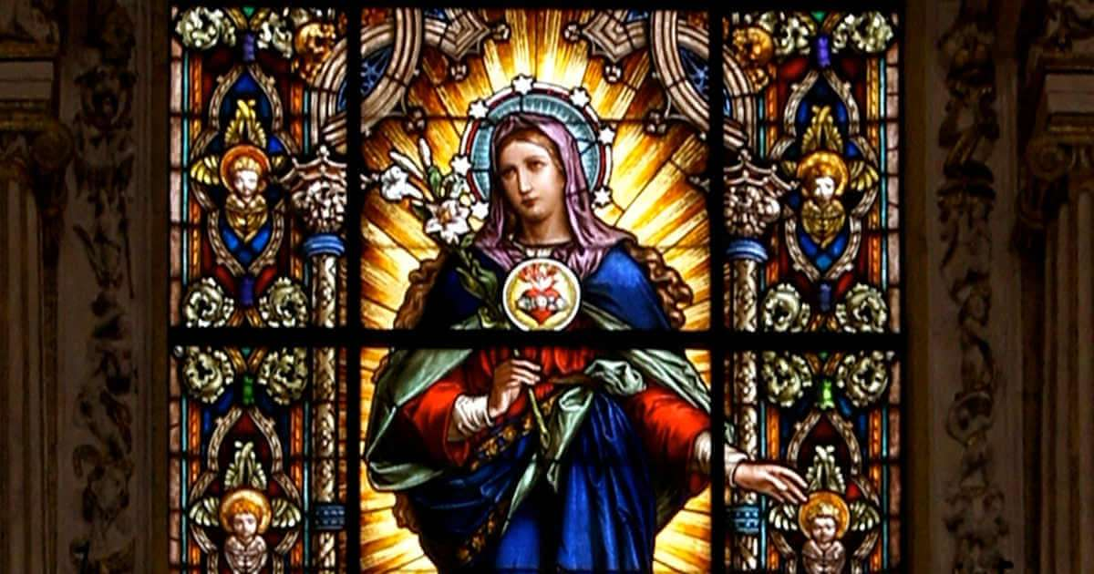

Slide 8
Consciously chosen love

Slide 9
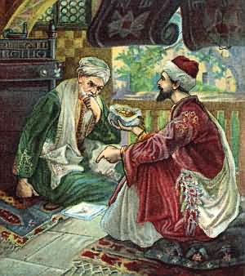
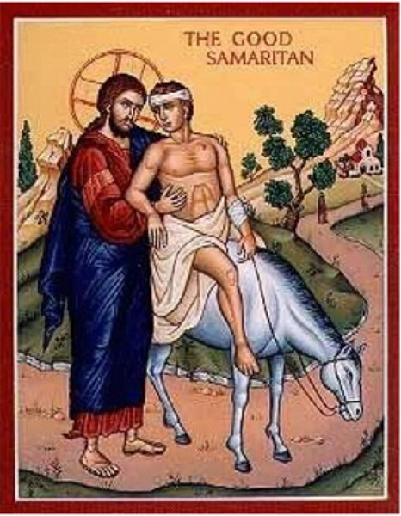

Slide 10
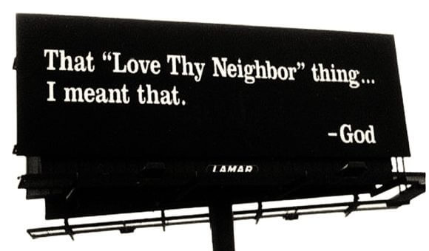
Thou shalt love thy neighbor as thyself
Who is my neighbor?

Slide 11
Who is my neighbor?

Slide 13
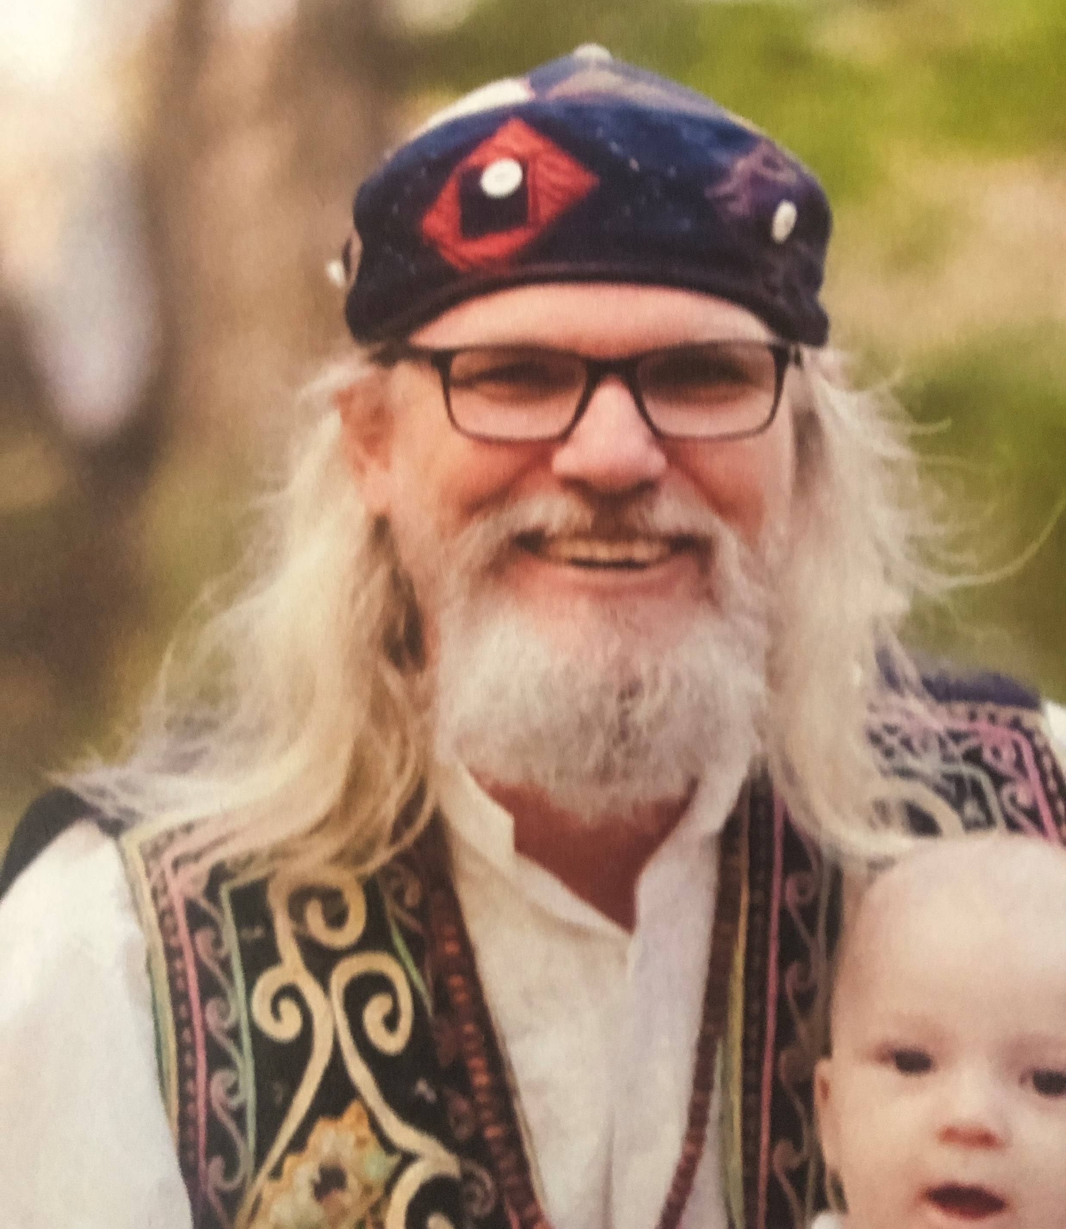
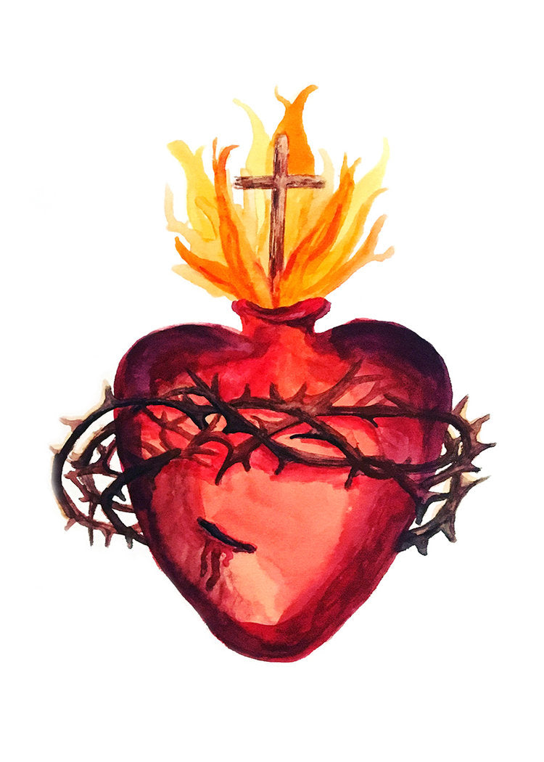
The Work says:
Psychologically
it has
to do
with those nearest you in Being

Slide 15
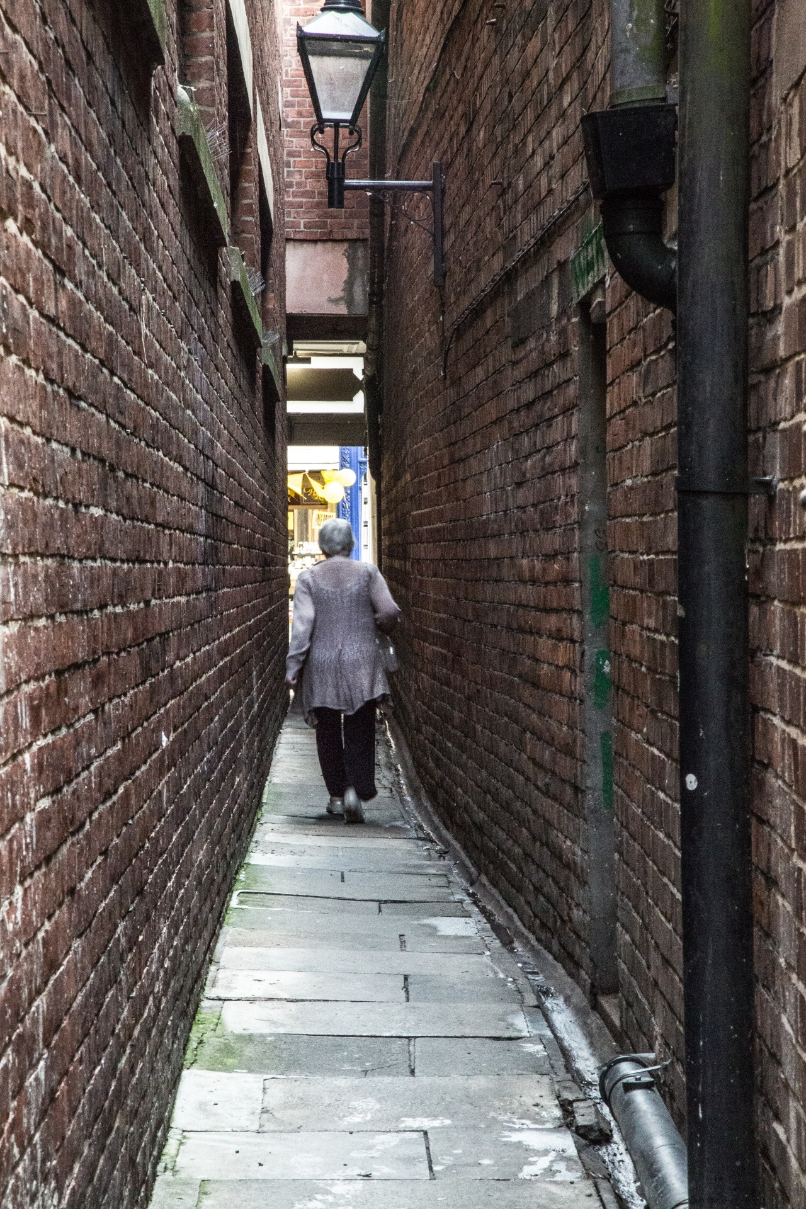
When you vow together you promise to consent to this sacred union taking you to…
The eye of the needle
The narrow mi-fa
The fifth way
My judgements are too wide to
pass through they must be left behind

Slide 16
LOVE ONE ANOTHER

Slide 17
Let your God Love You Edwina Gately
Be silent
Be still
Alone
Empty
Before your God
Say nothing
Ask nothing
Be silent
Be still
Let your God look upon you
That is all
God Knows

Slide 18
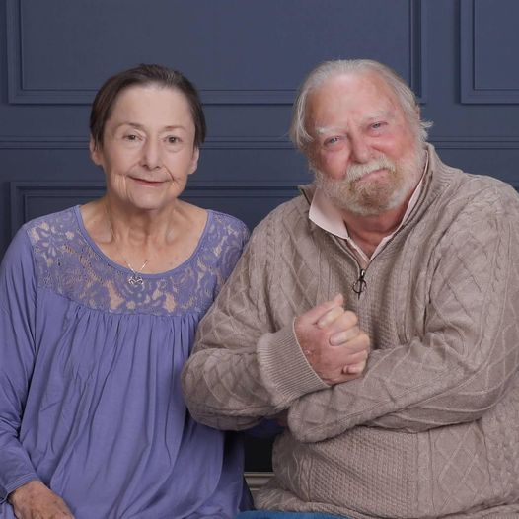
Ho’oponopno
“I am sorry, Please forgive me, I thank you and I love you.”

Slide 19
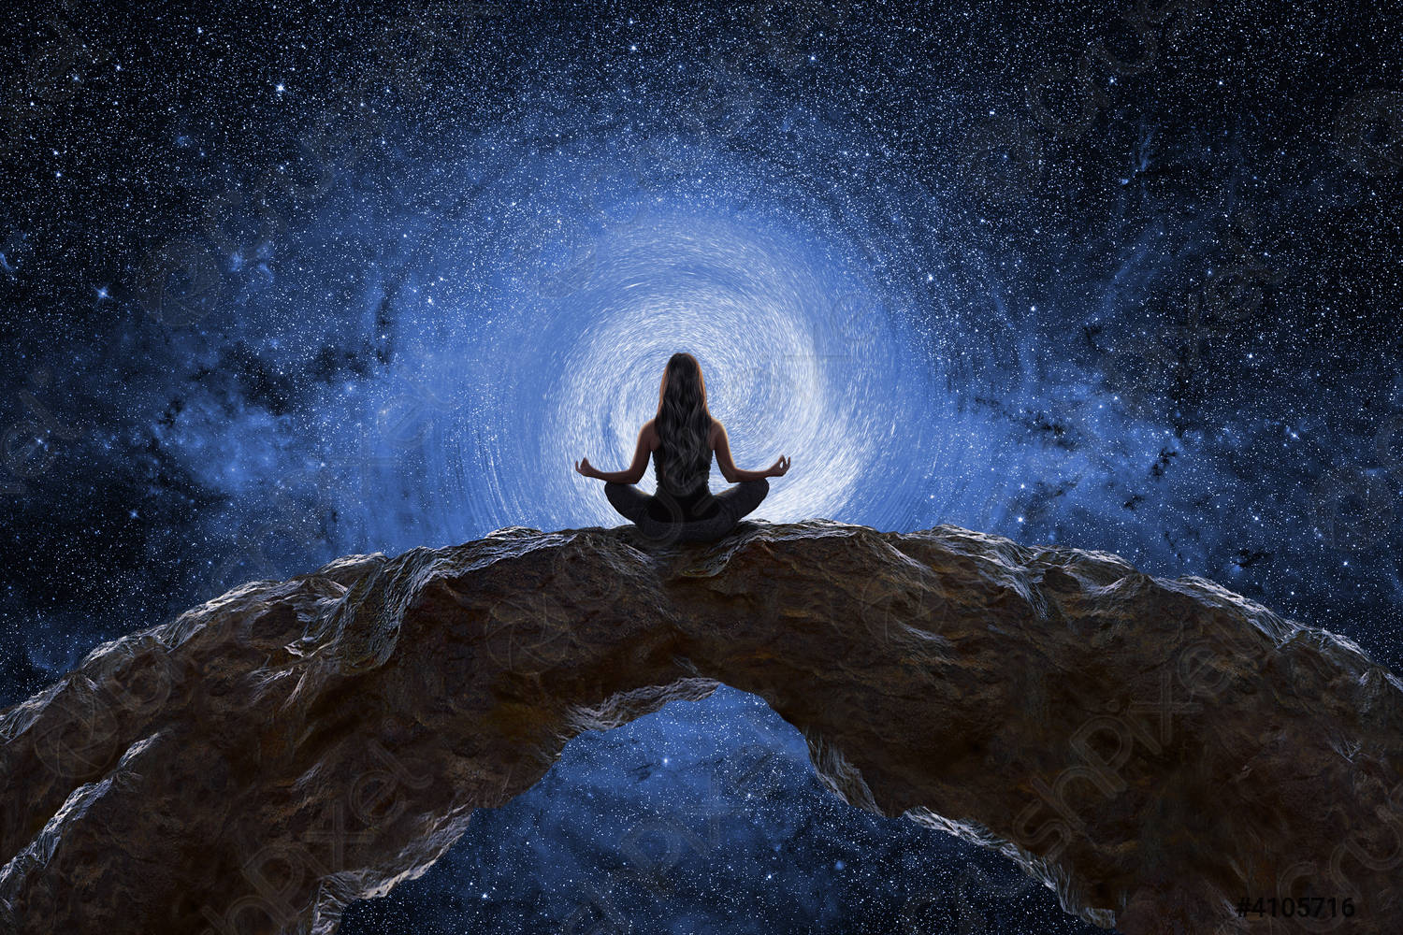
As thyself
Non-critical self-observation
Don’t should all over yourself

Slide 20
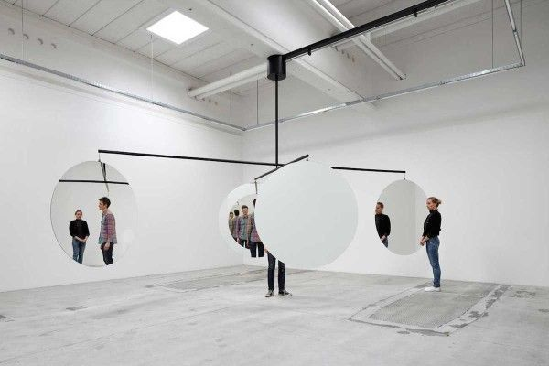
By finding the same thing in yourself,
you eventually see your neighbour
as yourself and yourself as
your neighbour. But you must know yourself to begin with. You must begin to be conscious of yourself. This is the most necessary part of Conscious Love, which is not blind.

Slide 21
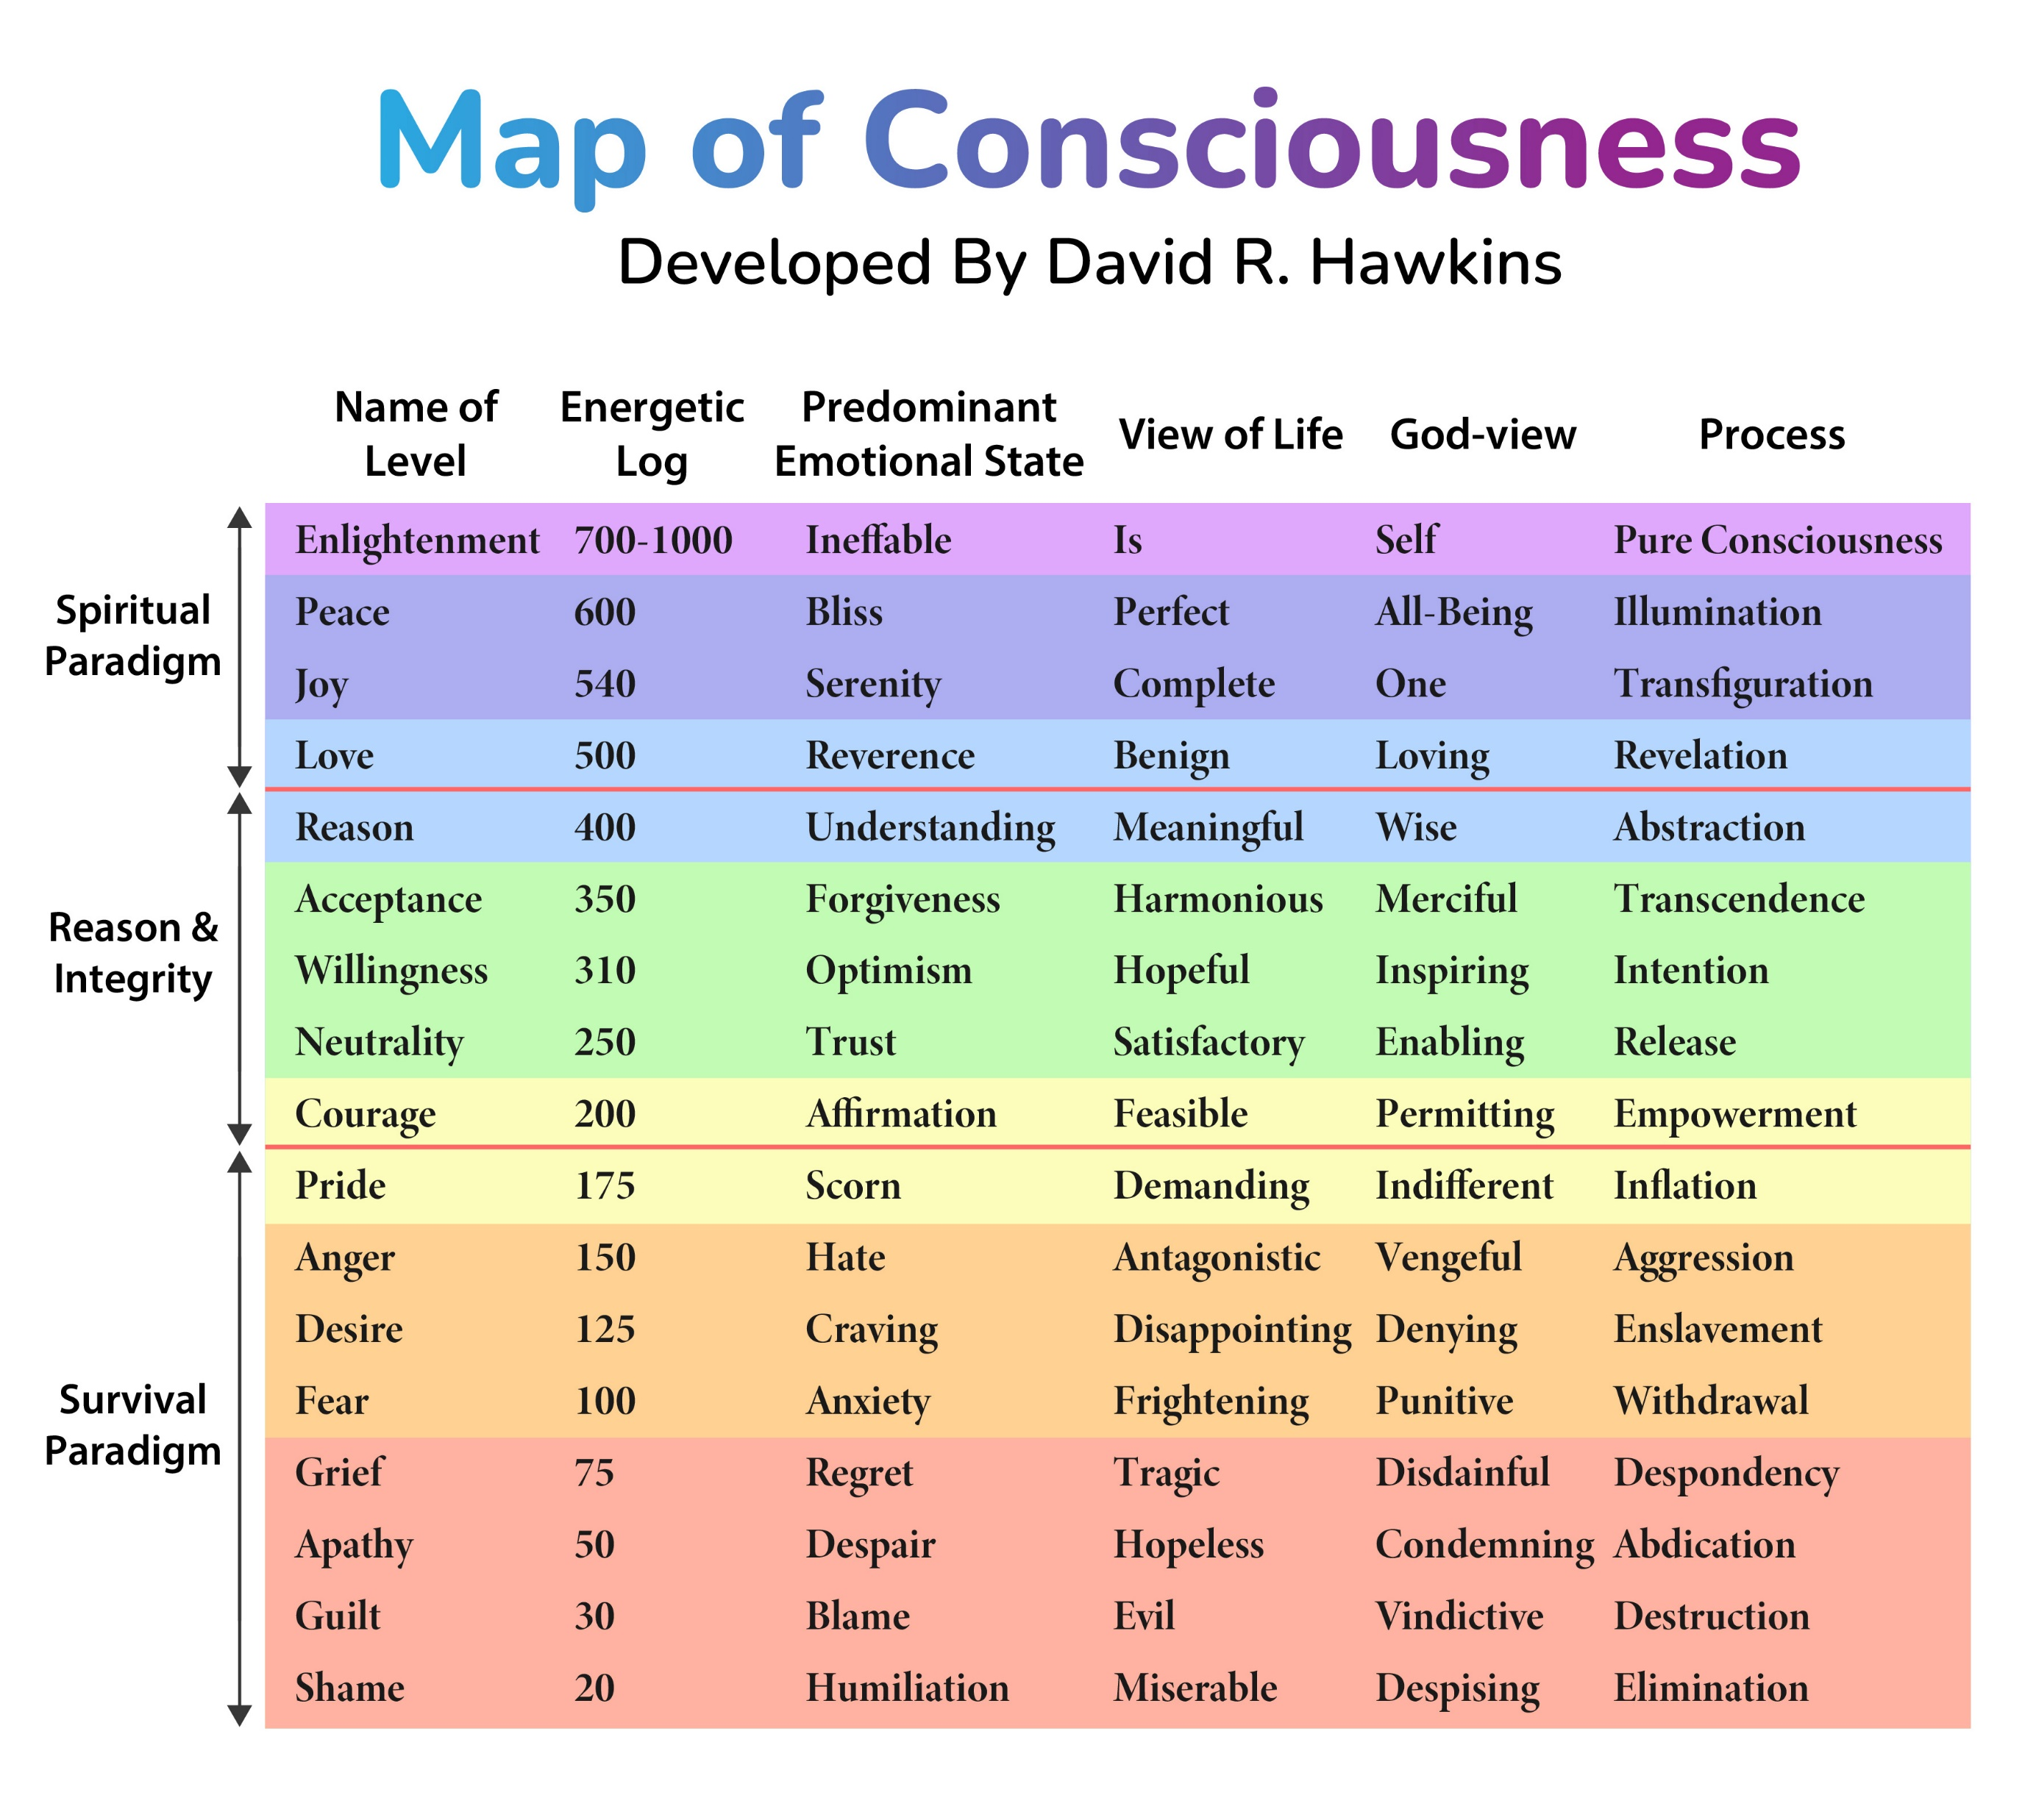
SUPER ATTRACTOR FIELDS
True spiritual states can be said to begin at a calibrated level of about 500 (Love), become Unconditional Love at 540.

Slide 22
One individual at level 500 counterbalances 750,000 individuals below 200.
One individual at level 700 counterbalances 70 million individuals below 200.
Were it not for these counterbalances, mankind would self destruct out of the sheer mass of its unopposed negativity.
Power vs. Force

Slide 23
More powerful attractor patterns to align with
jealous, possessive, self-serving, controlling, grasping, false personality

Slide 24
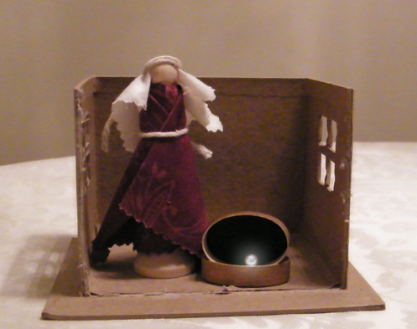
Conscious love
is something
that can be awakened within us

Slide 25
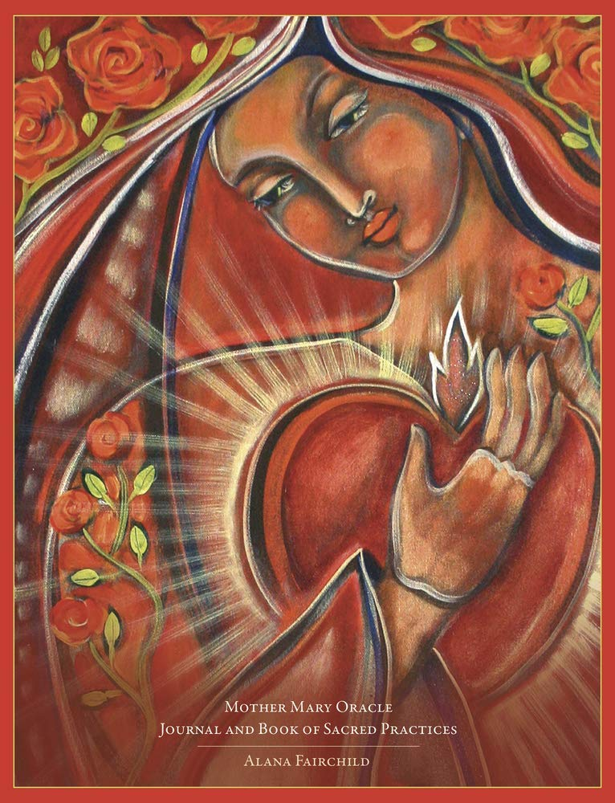
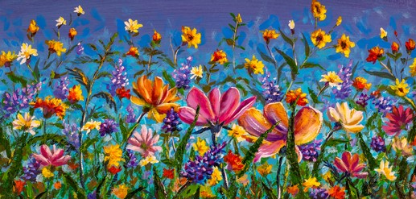
The heart creates a powerful magnetic field.
This field can be felt within and around us. As we grow spiritually, the electromagnetic field of the heart grows too, and our energetic influence can become important, not only to immediate family members, but to whole communities with which we are involved. We can continue to grow in that heart power and become influential and sustaining to the world around us. This can even operate to the point that a country we are travelling in at any given time will be impacted by our heart field through which grace can flow.

Slide 26
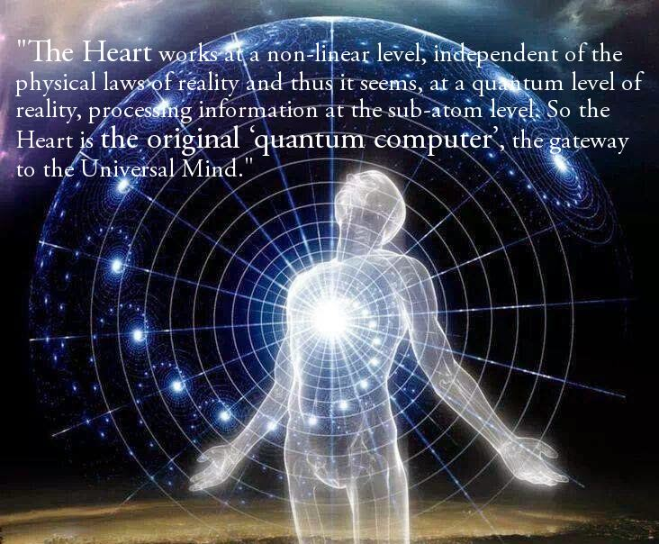

Slide 27
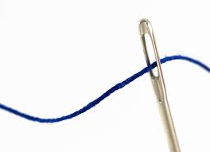
Only Real ‘I’
Can love consciously

Slide 28
Bits and pieces of this and that
from the false self system
fall away
As you eventually surrender everything
that is not true, not kind, that is in someway
unforgiving

Slide 29
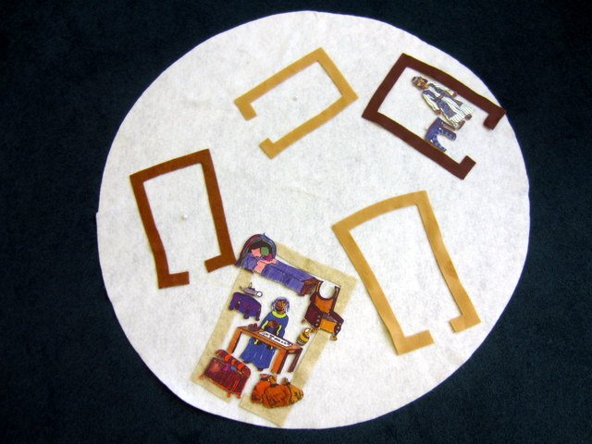
Conscious Love is stronger than anything in life

Slide 30
The Fruits of Centering Prayer
Silence
Solitude
Simplicity
Service
Ability to live in the present moment

Slide 31
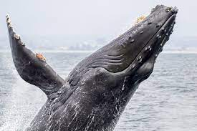
Falling Away
Not literally your
lamp and your bed
Desire to talk
Desire to leave the house
Memories
Roles and commitments
Travel
Old friendships
Things I was interested in before
Things I used to be able to do well

Slide 32
Making space and time
to live a
contemplative life.

Slide 33
There is no fear in love; perfect love casteth out fear.
1 John IV
John followed the way of Bhakti Yoga.
Commentary on Conscious Love P. 611-612 The object of this way is to get in touch with Higher Emotional Centre directly through love. John said that God is love and the only way in which love can be made perfect is to know and acknowledge the existence of God.
Bhakti Yoga: Recognition of the Divine in everything.

Slide 34
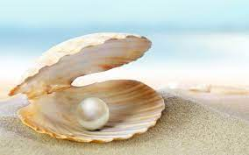
Conscious love changes the signs in us
+ - + and reverses - + -
them so that what was active becomes passive and what was passive becomes active.
It’s about personality and essence.

Slide 35
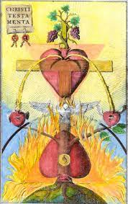
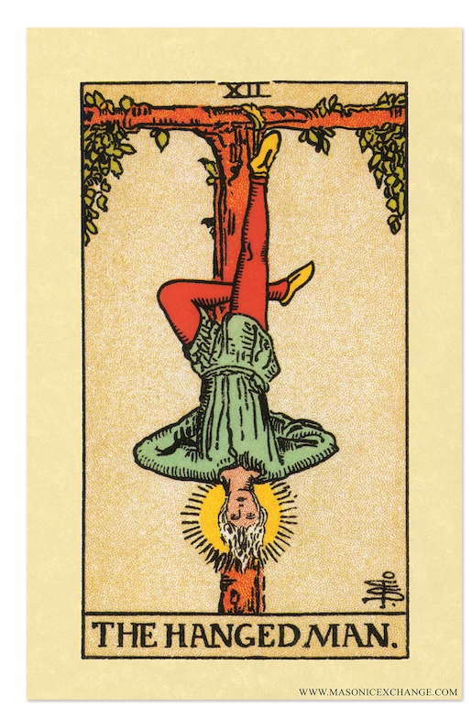
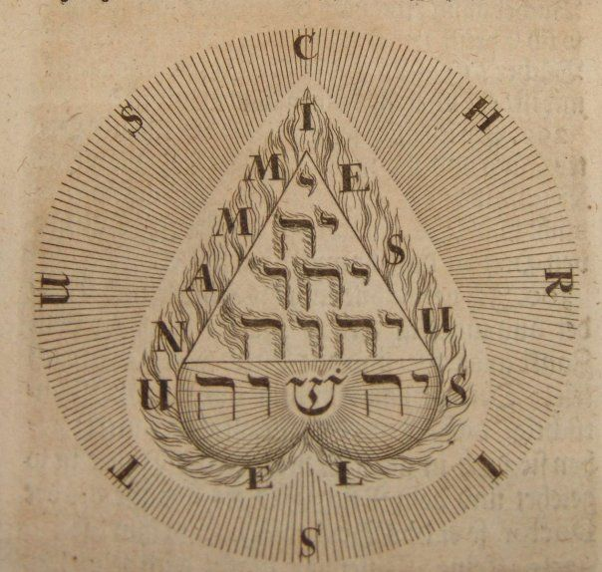
These images might be symbols that
convey the change that takes place when personality
becomes passive and essence becomes active.

Slide 36
Personality becomes passive
Essence becomes active
CONSENT
Choose conscious harmony consciously chosen love
Initiate harmonization sequence by consenting
Harmonize with the Mystery of Christ
Activate your Optimal Template
Sell everything you have valued…withdraw your attention.

Slide 37
Self observe
Find the same thing
in
yourself
Arrogance, superiority and intolerance fade because they are seen by you to be ridiculous.

Slide 38
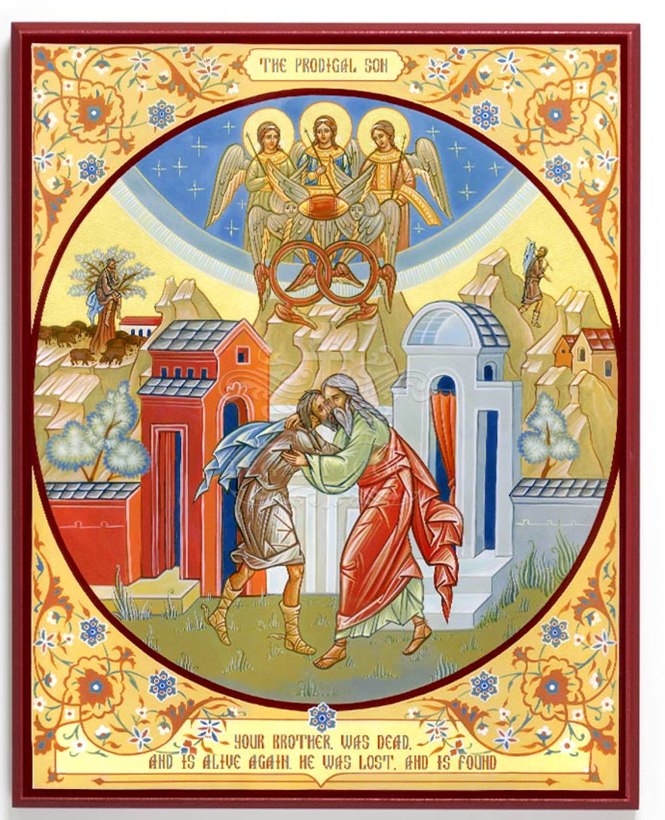
MOST
GENEROUS
INTERPRETATION
Finding the good inside
can come from asking this question:
What is my most generous interpretation of what just happened? Good Inside

Slide 39
Who is my neighbor?
Anyone thrown in my path
is my neighbor today.
Even if I never see them again
our invisible strings get entangled.

Slide 40
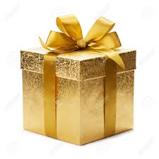
The Kingdom of Heaven
is like…

Slide 41
A
field

Slide 42
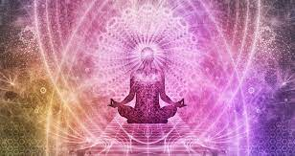
Jesus taught us how to manifest
within the field.
He has led us to the good green
grass and the cool clear water.

Slide 43
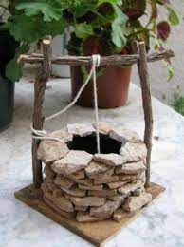
Can you taste the water?

Slide 44
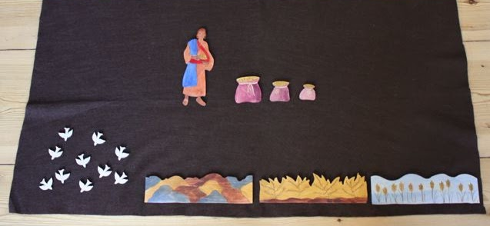
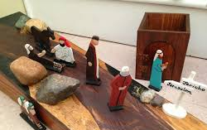
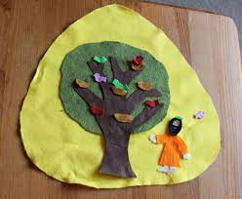
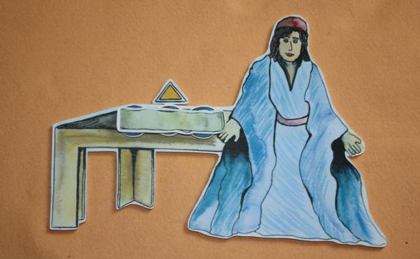
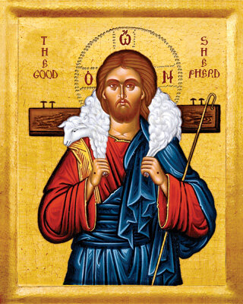
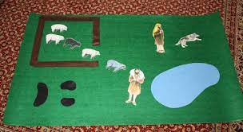
I wonder what is hidden inside a parable

Slide 45
The kingdom of heaven is like…
When someone who scatters seeds goes out and scatters them
A woman who hid the leaven
A man who sowed good seed in his field
A treasure hidden in a field
Finding the great pearl and exchanging everything for it
A person puts the tiny seed in the ground and it began to grow
A person invited many people to a great feast

Slide 46
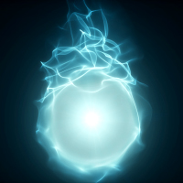
NOW!
past present future

Slide 47
The Journey School
June 22,2023

