Slide 1
Homework
Are you beginning to be able "to sense the immensity of the love that seeks to meet us at the crossroads of the Now, when we yield ourselves into it?
Can you recall even one difficult point in your own journey that you ultimately came to view as a grace? If so, can you go even further and surmise that current sticking points could also be a grace?
What do you wish to take with you from our sojourn through "Remembering Living Time?"
​

Slide 2
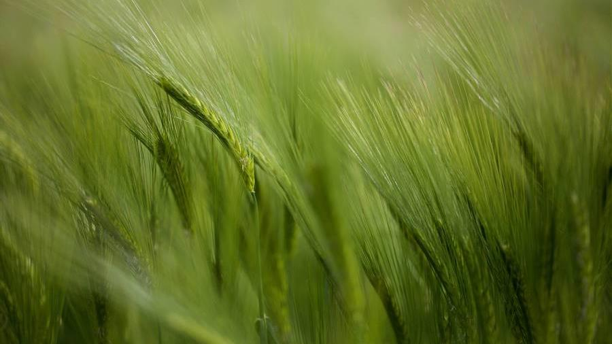
Remember Thyself
PART THREE
The Journey School
April 13, 2023​​

Slide 3
What is the Self that We Remember When We Self Remember?
Language Lineage
Sanskrit = Atman = Universal Self
vs. Ahamkara = EGO self
Or Citta = Mind
Proto Indo-European root = Sel-bho, SWE, subject of speaking, root is separate or apart from. This NOT that.
Greek = Autos = he, she, it,
Oneself, this very one
English = Seolf = one’s own person, same, identical (12th century), developed to refer to one’s property.

Slide 4
What is the Self that We Remember When We Self Remember?
Philosophical aspects
As the object of an Individual’s own reflective consciousness, as distinguishable from others.
As the reference by a subject to the same subject. Implying subjectivity. Subjectivity is directed outward or inward, from subject to refer to itself, as self. Implies First Person perspective. Interrupted by “this is not I.”
This self subjectivity can be interrupted in schizophrenia (where the self appears different from the subject), and can be interrupted in Self-Observation, Non-Identification, and divided by the idea of Multiplicity.

Slide 5
What is the Self that We Remember When We Self Remember?
PYCHOLOGICAL aspects
The Self and the unconscious and conscious.
"The self is not only the center but also the whole circumference which embraces both conscious and unconscious; it is the center of this totality.”
– Carl Jung

Slide 6
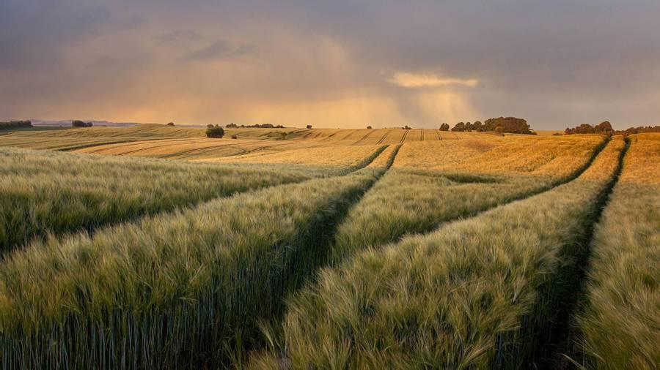
Greatest Commandment

Slide 7
The Gospel of Mark 12.30
“The foremost commandment is to love the Lord God with all your heart, soul, mind and strength.”

Slide 8
The Gospel of Mark 12.31
“The second commandment is this: Love your neighbor as yourself.”

Slide 9
Beyond Self
More than self
The old, unworkable self is seen.
A new self arises
Anyone in Christ is a new creation.
– 2 Corinthians 5.17
I, Not I, Christ in me.
- Galatians 2.20
Beyond self
​Live dead to self, alive to God.
-Romans 6.11
I have died and my life is hidden with Christ in God.
- Colossians 3.3

Slide 10
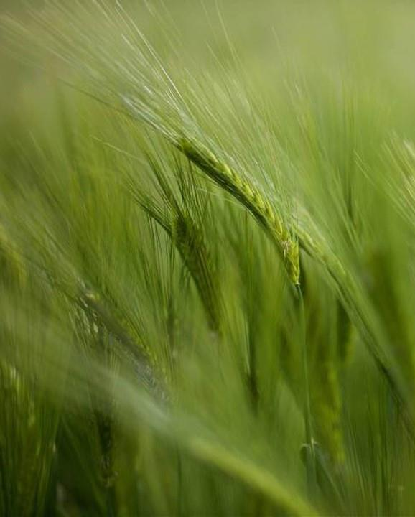
Homework
“Very truly I tell you, unless a kernel of wheat falls to the ground and dies, it remains only a single seed. But if it dies, it produces many seeds.” - John 12.24
During the upcoming week, re-read this email slowly at least three times. Observe what speaks to you. Observe what does not.
Verify: by way of self-observation, where you verify these Work teachings in your own life. Study the nature of your self. Study the nature of your being. Study the nature of your consciousness. What can you verify for yourself? This is not just esoteric teaching. It's your life, what is under your hood, so to speak?
Express your gratitude for the gift of life – and these three gifts of self, being and consciousness. How? Use them. Share them. Expand them. Delight in them. And share what you discover or experience.

